Slide 1
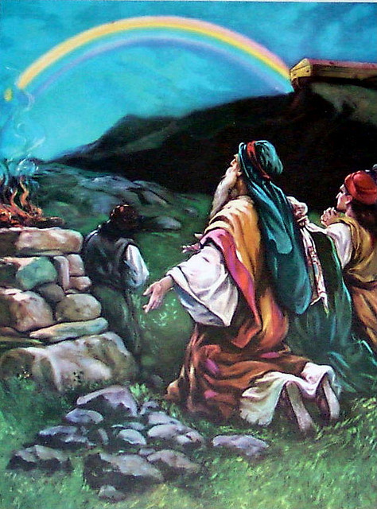
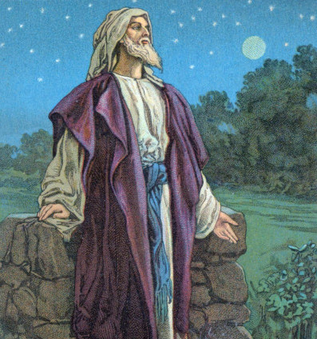
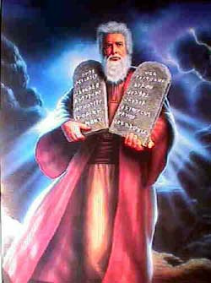
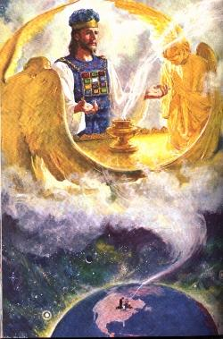
OUR ROLE IN GOD’S COVENANTS – Part 2
Moses
Jesus
Noah
Abraham

Slide 2
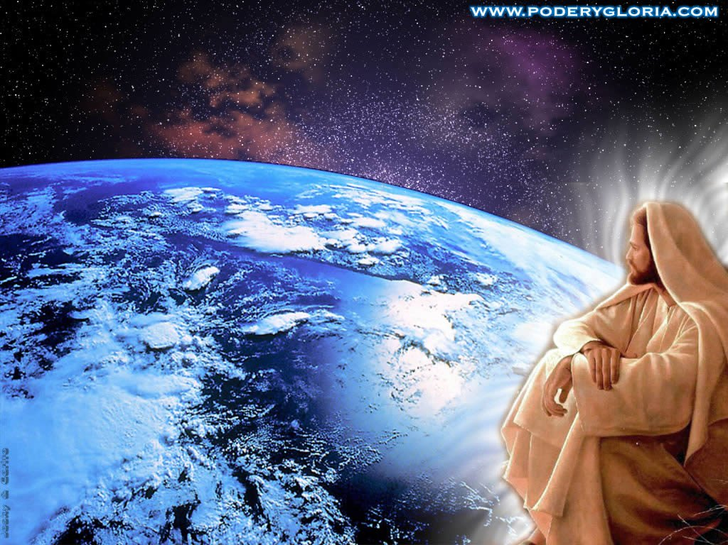
ONCE FOR ALL
Hymn #54

Slide 3
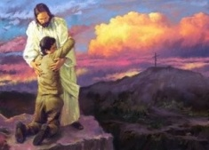
Free from the law, O happy condition!
Jesus our Lord, hath purchased remission;

Slide 4
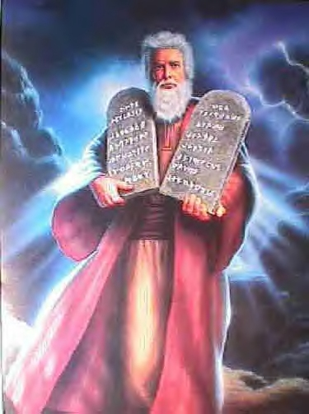
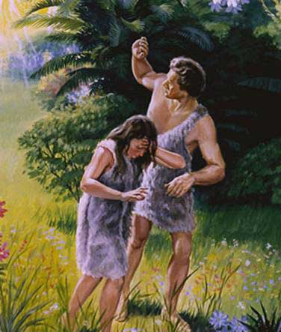
Cursed by God's law and bruised by the fall,
Grace hath redeemed us once for all.

Slide 5
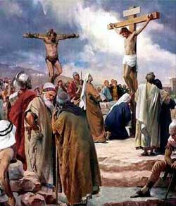
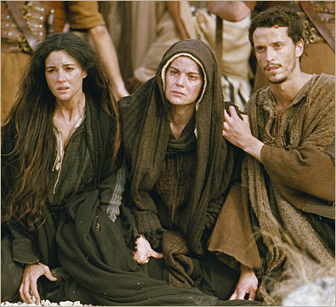
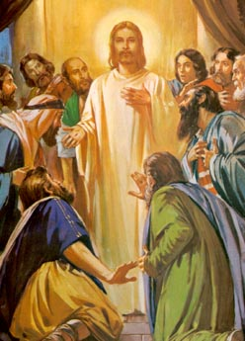
CHORUS
Once for all! O yes! we believe it;
Once for all! by faith we receive it;
Lo, at his cross all burdens will fall,
Christ hath redeem'd us once for all.

Slide 6
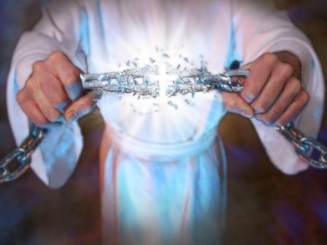
Now we are free, there's no condemnation;
Jesus will soon perfect our salvation;

Slide 7
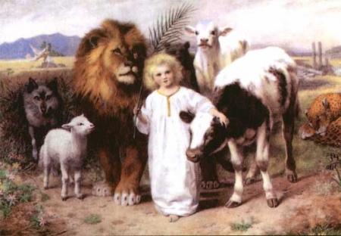
His kingdom soon shall rule over all,
Saving the willing from the fall.

Slide 8
CHORUS
Once for all! O yes! we believe it;
Once for all! by faith we receive it;
Lo, at his cross all burdens will fall,
Christ hath redeem'd us once for all.

Slide 9
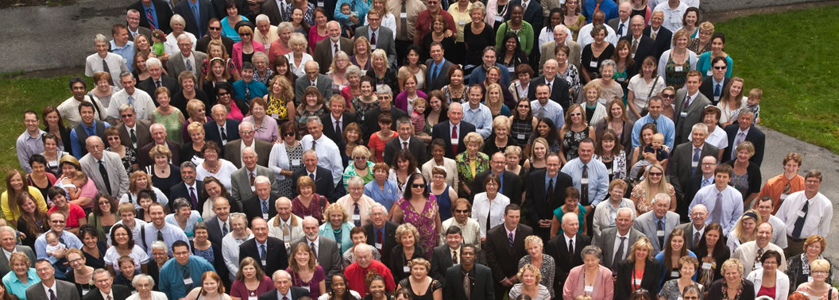
Children of God, O glorious calling!
Surely his grace will keep us from falling;

Slide 10

Passing from death to life at his call,
Blessed salvation! once for all.

Slide 11
CHORUS
Once for all! O yes! we believe it;
Once for all! by faith we receive it;
Lo, at his cross all burdens will fall,
Christ hath redeem'd us once for all.

Slide 12
Daily Heavenly Manna February 17
Take My yoke upon you,...for My yoke is easy, and My burden is light. Matthew 11:29,30
THOSE who wear this yoke have the assurances of the divine Word that all things are working together for good to them; that the heavier the burden that may be attached, the greater will be the blessing and the reward by and by; the more severe the experiences during the present time, the brighter shall be the glory, and the brighter shall be their character, and the more sure shall they be of being fitted and polished for the heavenly Kingdom. From this standpoint every burden is light, because our yoke is appreciated, and is so easy, so reasonable: and additionally it is so light because the Lord is with us in this yoke. `Z.'00-137` R2625:5

Slide 13
OUR ROLE IN GOD’S COVENANTS – Part 2
Moses
Jesus
Noah
Abraham
Notes:
Today we would like to continue with Part 2 of our discussion begun last year on “Our Role in God’s Covenants.” Let’s summarize what we covered in part 1.

Slide 14
SUMMARY – OUR ROLE IN GOD’S COVENANTS PART 1
A Bible Covenant is a contract ratified by sacrifices.

Slide 15
SUMMARY – OUR ROLE IN GOD’S COVENANTS PART 1
A Bible Covenant is a contract ratified by sacrifices.
The Jeremiah 31 New Covenant is made with Natural Israel.

Slide 16
SUMMARY – OUR ROLE IN GOD’S COVENANTS PART 1
A Bible Covenant is a contract ratified by sacrifices.
The Jeremiah 31 New Covenant is made with Natural Israel.
Per Romans 11, the New Covenant is made with Natural Israel after the Church’s sacrifice is complete (when the earthly kingdom is established).

Slide 17
SUMMARY – OUR ROLE IN GOD’S COVENANTS PART 1
A Bible Covenant is a contract ratified by sacrifices.
The Jeremiah 31 New Covenant is made with Natural Israel.
Per Romans 11, the New Covenant is made with Natural Israel after the Church’s sacrifice is complete (when the earthly kingdom is established).
Jesus is the “surety” or “guarantee” of the New Covenant. There would be no need for this if the New Covenant were already operational.

Slide 18
SUMMARY – OUR ROLE IN GOD’S COVENANTS PART 1
A Bible Covenant is a contract ratified by sacrifices.
The Jeremiah 31 New Covenant is made with Natural Israel.
Per Romans 11, the New Covenant is made with Natural Israel after the Church’s sacrifice is complete (when the earthly kingdom is established).
Jesus is the “surety” or “guarantee” of the New Covenant. There would be no need for this if the New Covenant were already operational.
Drinking the Cup shows the Church with Jesus ratifies the New Covenant

Slide 19
SUMMARY – OUR ROLE IN GOD’S COVENANTS PART 1
A Bible Covenant is a contract ratified by sacrifices.
The Jeremiah 31 New Covenant is made with Natural Israel.
Per Romans 11, the New Covenant is made with Natural Israel after the Church’s sacrifice is complete (when the earthly kingdom is established).
Jesus is the “surety” or “guarantee” of the New Covenant. There would be no need for this if the New Covenant were already operational.
Drinking the Cup shows the Church with Jesus ratifies the New Covenant
Hebrew 12 shows we are drawing near to, but have not yet arrived at, Mount Zion and the New Covenant.

Slide 20
SUMMARY – OUR ROLE IN GOD’S COVENANTS PART 1
A Bible Covenant is a contract ratified by sacrifices.
The Jeremiah 31 New Covenant is made with Natural Israel.
Per Romans 11, the New Covenant is made with Natural Israel after the Church’s sacrifice is complete (when the earthly kingdom is established).
Jesus is the “surety” or “guarantee” of the New Covenant. There would be no need for this if the New Covenant were already operational.
Drinking the Cup shows the Church with Jesus ratifies the New Covenant
Hebrew 12 shows we are drawing near to, but have not yet arrived at, Mount Zion and the New Covenant.
No Bible verse in the New Testament says that God makes the New Covenant with the Church.
Notes:
Read screen.
Now let’s continue with Part 2 of Our Role in God’s Covenants.

Slide 21
HOW IS THE CHURCH GIVEN FOR A COVENANT OF THE PEOPLES?
Isaiah 49:8: (KJV) Thus saith the LORD, In an acceptable time have I heard thee, and in a day of salvation have I helped thee: and I will preserve thee, and GIVE THEE FOR A COVENANT OF THE PEOPLE, to establish the earth, to cause to inherit the desolate heritages.
In II Cor 6:2 and Acts 13:47 this text is applied to Christians.
Notes:
[Read screen] Who here is given for a covenant of the peoples? [press ENTER] We are given the answer in II Cor 6:2 and Acts 13:47, where Isa 49:8 is applied to Christians. The fact that the Christian Church is "given for a covenant of the peoples," when compared with Isa 42:6

Slide 22
HOW IS THE CHURCH GIVEN FOR A COVENANT OF THE PEOPLES?
Isaiah 42:6: (KJV) I the LORD have called thee in righteousness, and will hold thine hand, and will keep thee, and give thee for A COVENANT OF THE PEOPLE, for a light of the Gentiles...
Verses 1-3 of Isaiah 42 are quoted in Matt 12:17-21, where they are applied to Jesus.
Notes:
…demonstrates that the true Christian Church [the New Creation] cannot be under the New Covenant. [read Isaiah 42:6] [press ENTER] Verses 1-3 of Isaiah 42 are quoted in Matt 12:17-21, where they are applied to Jesus.

Slide 23
HOW IS THE CHURCH GIVEN FOR A COVENANT OF THE PEOPLES?
Isaiah 49:8: (KJV) I will preserve thee, and GIVE THEE FOR A COVENANT OF THE PEOPLE – CHRISTIAN CHURCH
Isaiah 42:6: (KJV) I the LORD… will keep thee, and give thee for A COVENANT OF THE PEOPLE - JESUS
Notes:
To be consistent, if the Church's being "given for a covenant of the peoples" means that they are under the New Covenant, then to be consistent we must conclude that Jesus being "given for a covenant of the people" would mean that he also is under the New Covenant.

Slide 24
HOW IS THE CHURCH GIVEN FOR A COVENANT OF THE PEOPLES?
Isaiah 49:8: (KJV) I will preserve thee, and GIVE THEE FOR A COVENANT OF THE PEOPLE – CHRISTIAN CHURCH
Isaiah 42:6: (KJV) I the LORD… will keep thee, and give thee for A COVENANT OF THE PEOPLE - JESUS
Notes:
However, Jesus cannot be under it since he is both the new covenants mediator and the sacrifice that ratifies it. Hence, neither can the Church be under it.

Slide 25
HOW IS THE CHURCH GIVEN FOR A COVENANT OF THE PEOPLES?
Isaiah 49:8: (KJV) I will preserve thee, and GIVE THEE FOR A COVENANT OF THE PEOPLE – CHRISTIAN CHURCH
Isaiah 42:6: (KJV) I the LORD… will keep thee, and give thee for A COVENANT OF THE PEOPLE - JESUS
Notes:
We believe then that the Church shares Jesus’ position as both the New Covenant’s mediator and also the sacrifice which ratifies this covenant.

Slide 26
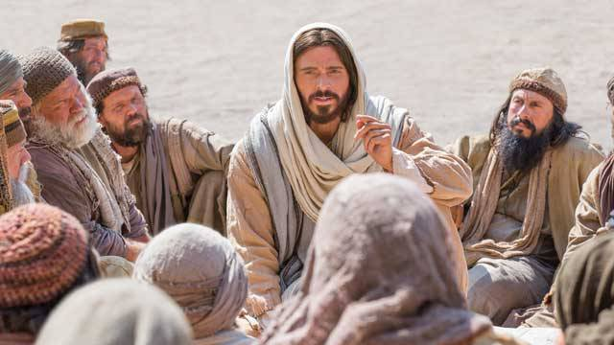
HOW ARE WE MINISTERS OF THE NEW COVENANT?
2 Corinthains 3:3 (NASV) ... you are a letter of Christ, cared for by us, written not with ink but with the Spirit of the living God, not on tablets of stone but on tablets of human hearts.
Notes:
[read question] A common passage quoted to prove the view that the Church is now under the New Covenant is found in [read 2 Cor 3:3]. Many Christians believe that this verse applies to the Jeremiah 31:33 statement that God's Laws will be written on their hearts.

Slide 27
HOW ARE WE MINISTERS OF THE NEW COVENANT?
2 Corinthains 3:3 (NASV) ... you are a letter of Christ, cared for by us, written not with ink but with the Spirit of the living God, not on tablets of stone but on tablets of human hearts.
Notes:
We answer that the future Administrators of the New Covenant must have God's spirit written in their hearts in order to impart the same to mankind.

Slide 28
HOW ARE WE MINISTERS OF THE NEW COVENANT?
2 Corinthians 3:3 (NASV) ... you are a letter of Christ, cared for by us, written not with ink but with the Spirit of the living God, not on tablets of stone but on tablets of human hearts.
Duet 11:18: “You shall therefore impress these words of mine on your heart...”
Prov 7:2-3: “Keep my commandments and live... Write them on the tablet of your heart."
Notes:
It is a mistake to insist that the only way to impart God's laws or spirit into man's heart is through the New Covenant. [press RETURN] For example, under the Old Law Covenant we read [read scriptures] So we see that even the Israelites under the old Mosaic Law Covenant were to have God’s Laws written in their heart.

Slide 29
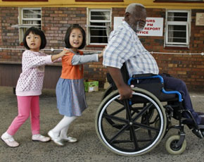

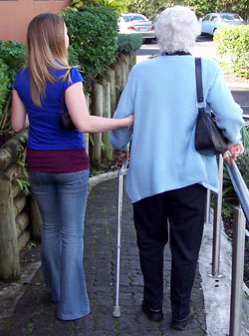

HOW ARE WE MINISTERS OF THE NEW COVENANT?
Romans 2:14,15 (NASV) “14 For when Gentiles who do not have the Law do instinctively the things of the Law, these, not having the Law, are a law to themselves, 15 in that they show the work of the Law written in their hearts, their conscience bearing witness and their thoughts alternately accusing or else defending them…”
Notes:
To go one step further, God's law is even said to reside in the hearts of unbelievers through their conscience. [Read Romans 2] Remnants of God's original law placed in Adam's heart remain with all mankind, even if this glimmer of conscience is often distorted by superstition and error.

Slide 30
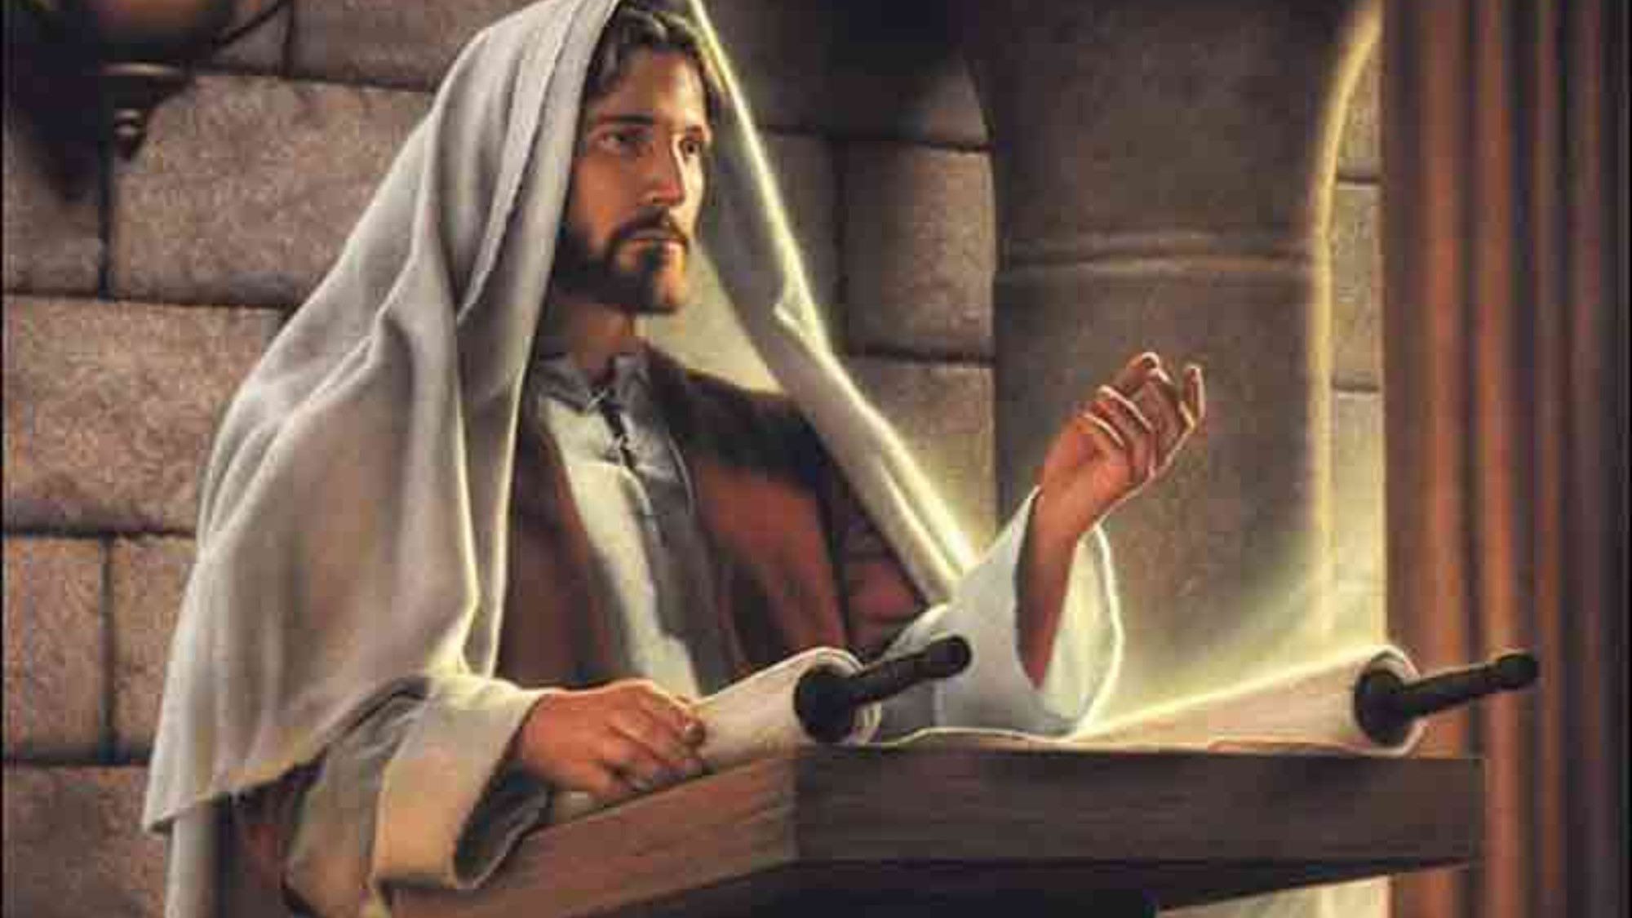
Notes:
For Jesus, God's laws are even more perfectly in His heart. Yet we do not say that Jesus is under the New Covenant just because God's Laws are in his heart. Nor should we feel compelled to say that the Church is under the New Covenant since God's laws are in our heart.

Slide 31
HOW ARE WE MINISTERS OF THE NEW COVENANT?
2 Corinthians 3:6: “...who also has made us adequate as servants [ministers] of a New Covenant, not of the letter, but of the Spirit; for the letter kills, but the Spirit gives life.”
Malachi 3:1: (NASV) “Behold, I am going to send My messenger, and he will clear the way before Me. And the Lord, whom you seek, will suddenly come to His temple; and the messenger of the covenant, in whom you delight, behold, He is coming," says the LORD of hosts.”
Notes:
Let’s look at the New Creature’s relationship to the New Covenant as its ministers or servants. [Read 2 Cor 3:6] Being servants or ministers of the New Covenant makes us teachers and representatives of that covenant to others. We are serving the New Covenant in the same sense that Jesus served it. [Press ENTER] Let's read [Read Malichi 3:1]

Slide 32
HOW ARE WE MINISTERS OF THE NEW COVENANT?
2 Corinthians 3:6: “...who also has made us adequate as servants [ministers] of a New Covenant, not of the letter, but of the Spirit; for the letter kills, but the Spirit gives life.”
Malachi 3:1: (NASV) “Behold, I am going to send My messenger, and he will clear the way before Me. And the Lord, whom you seek, will suddenly come to His temple; and the messenger of the covenant, in whom you delight, behold, He is coming," says the LORD of hosts.”
Notes:
Jesus is described as the messenger or servant of the Covenant (that is of the New Covenant) and each one of the Church now being called and chosen becomes a servant and messenger of the New Covenant. Jesus and His body members, the Church, are ministers of the New Covenant to the world, just as Moses was the minister of the Law Covenant to Israel.

Slide 33
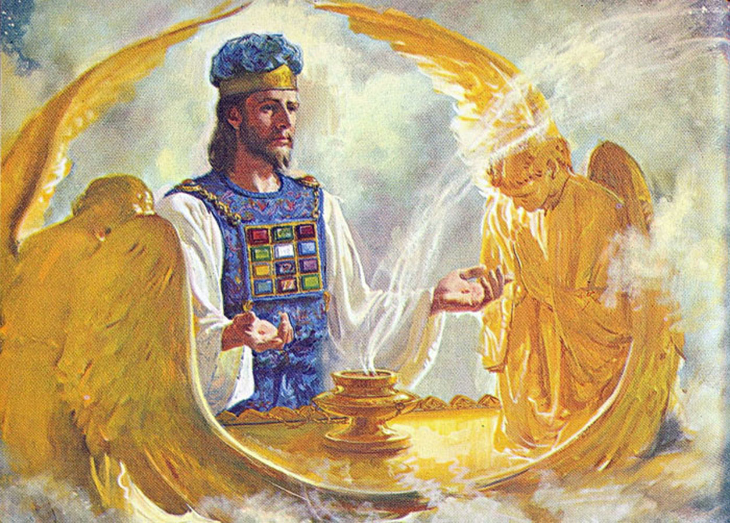
HOW ARE WE MINISTERS OF THE NEW COVENANT?
R5294:3: "Unless there were Better Sacrifices, there would be no basis for that New Covenant. The sufferings which the Church undergo at this present time are a blessed privilege to us; for we are ministers of that New Covenant, in the sense that we are serving it by training for future service--after it shall have been inaugurated."
Notes:
Read screen

Slide 34
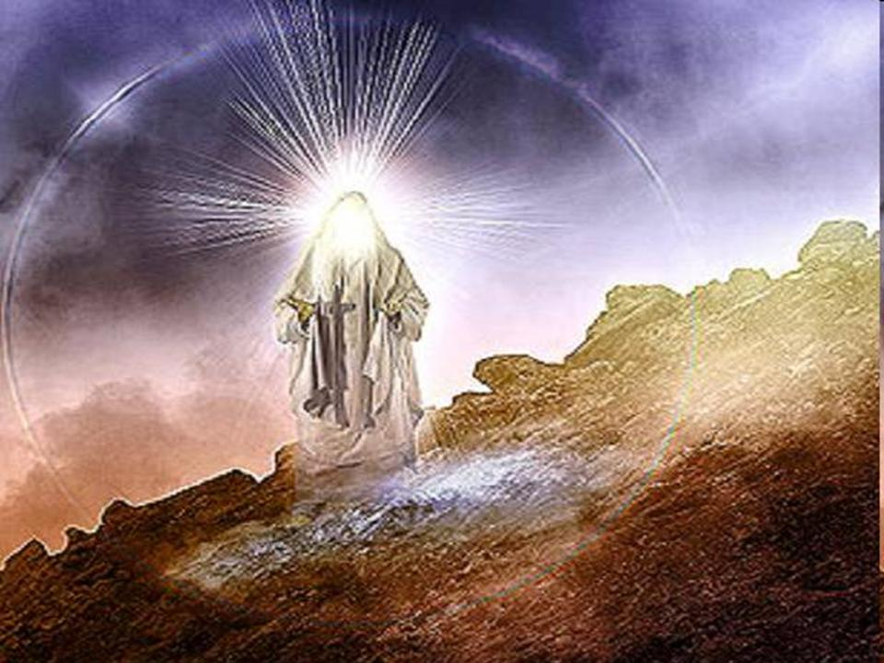
HOW ARE WE MINISTERS OF THE NEW COVENANT?
2 Cor. 3:7,8: “But if the ministry of death in letters engraved on stones, came with glory, so that the sons of Israel could not look intently at the face of Moses because of the glory of his face, fading as it was, how shall the ministry of the Spirit fail to be even more with glory?”
Notes:
[Read screen] Ex.34:29-35 tells us that after the LORD had spoken to him, Moses would come down from Mount Sinai with his face shining and would relay God's message to the people of Israel. 2 Cor 3:13 shows us that after speaking to the people, Moses would cover his face with a veil so that they would not see his fading glory.

Slide 35
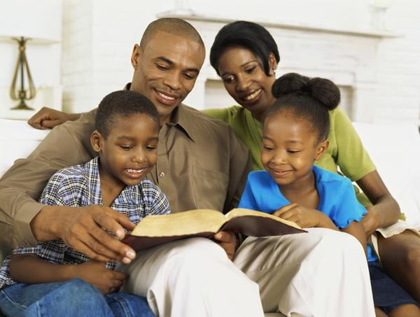

HOW ARE WE MINISTERS OF THE NEW COVENANT?
2 Cor. 3:18: (NASV) “But we all with unveiled face beholding as in a mirror the glory of the LORD, are BEING TRANSFORMED into the same image from glory to glory, just as from the LORD, the Spirit.”
Notes:
[Read 2 Cor 3:18] Just as when on Mount Sinai Moses beheld the glory of the Lord and his face shone, so we through the scriptures behold the glory of the LORD and reflect his character in our Christian walk.

Slide 36
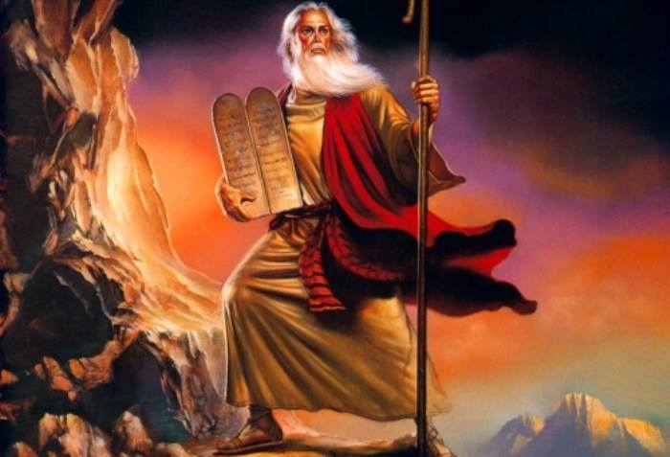
Notes:
Moses went up and down from the mountain to relay God's message to the people in his role as the Mediator of the Law Covenant. So in the kingdom, as a part of the Mediator of the New Covenant…

Slide 37
Notes:
…the Church will descend from Mount Zion [the heavenly phase of God’s kingdom] and relay God's message to the people of the world. Yet if the passage says that we are NOW ministers of the New Covenant, why then are we applying this work to the future?

Slide 38
HOW ARE WE MINISTERS OF THE NEW COVENANT?
2 Cor. 3:18: (NASV) “But we all with unveiled face beholding as in a mirror the glory of the LORD, are BEING TRANSFORMED into the same image from glory to glory, just as from the LORD, the Spirit.”
Notes:
Actually the work is both now and in the future. Notice how verse 18 says that we are "being transformed." Through our work now of ministering and teaching the kingdom to others we are being transformed or prepared for our future work as mediators of the New Covenant.

Slide 39
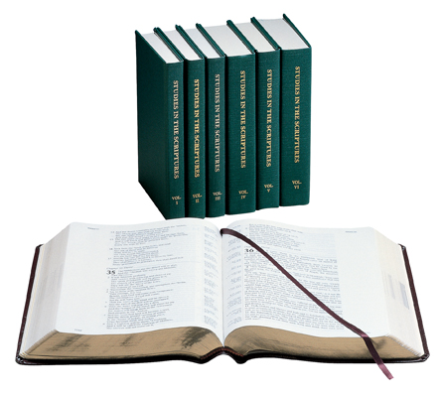
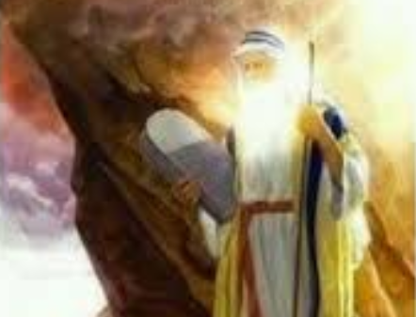

HOW ARE WE MINISTERS OF THE NEW COVENANT?
2 Cor. 3:18: (NASV) “But we all with unveiled face beholding as in a mirror the glory of the LORD, are BEING TRANSFORMED into the same image from glory to glory, just as from the LORD, the Spirit.”
Notes:
Before the Law Covenant was ever ratified (Ex. 24), Moses had already gone up and down the mount to relay God's words to the people. So even now, before the New Covenant has been fully ratified, we, as ministers of the New Covenant are relaying God's message to the people, but we will do so in a much more effective way and on a grander scale in God’s kingdom.

Slide 40
WHY IS JESUS THE MEDIATOR OF THE NEW COVENANT?
Hebrews 9:15 (NASV95), “For this reason (a reason Paul is now about provide) He is the mediator of a new covenant, so that, since a death (Jesus death on the cross) has taken place for the redemption of the transgressions that were committed under the first covenant (Jesus redeemed the Jews from the curse of the Law Gal 3:13), those who have been called (the Church Heb 3:1) may receive the promise of the eternal inheritance” (Heavenly seed of Abraham to bless all nations - Heb 6:17 - by administering the New Covenant to Israel and mankind as Jesus' body members)
Notes:
[Read question] For the answer, let’s start by reading Hebrews 9:15. To understand this verse we need pull in other Bible verses that reveal what Paul means. We have added some explanatory comments in gray font. [read Heb 9:15]

Slide 41
WHY IS JESUS THE MEDIATOR OF THE NEW COVENANT?
Hebrews 9:15 (NASV95), “For this reason (a reason Paul is now about provide) He is the mediator of a new covenant, so that, since a death (Jesus death on the cross) has taken place for the redemption of the transgressions that were committed under the first covenant (Jesus redeemed the Jews from the curse of the Law Gal 3:13), those who have been called (the Church Heb 3:1) may receive the promise of the eternal inheritance” (Heavenly seed of Abraham to bless all nations - Heb 6:17 - by administering the New Covenant to Israel and mankind as Jesus' body members)
Notes:
In other words, Jesus is the mediator of the New Covenant for the purpose fulfilling the Abrahamic promise (our eternal inheritance) by blessing Israel and all mankind under the New Covenant (with the participation of His body members, the spiritual seed). Before there was any hope that the New Covenant would bless Israel, Jesus had to first redeem Israel from the curse of the Law. (Gal 3:13). How do we know that the “the eternal inheritance” of Heb 9:15 is referring to the work of the heavenly seed, the bride of Christ?

Slide 42
“ETERNAL INHERITANCE” – WORK OF HEAVENLY SEED
Hebrews 6:17-20 (NASV) “17 In the same way God, desiring even more to show to the heirs of the promise the unchangeableness of His purpose, interposed with an oath, 18 so that by two unchangeable things in which it is impossible for God to lie, we who have taken refuge would have strong encouragement to take hold of the hope set before us. 19 This hope we have as an anchor of the soul, a hope both sure and steadfast and one which enters within the veil, 20 where Jesus has entered as a forerunner for us, having become a high priest forever according to the order of Melchizedek.
Notes:
[Read Heb 6] The "eternal inheritance“ of Heb 9:15 is this promise to be part of the spiritual seed of Abraham. Our membership in Christ's body makes us heirs of the Abrahamic promise (vs 17) and of the hope (vs 18) of following our High Priest Jesus through the Veil (vs 19) to share in the work of the priesthood. The word "forerunner" (vs 20) means that we are following after Jesus, into the Most Holy into the "Presence behind the veil," that is the presence of God himself, as represented by the shekinah light emanating from the ark.

Slide 43
“ETERNAL INHERITANCE” – WORK OF HEAVENLY SEED
Hebrews 9:14 (NASV) “how much more will the blood of Christ, who through the eternal Spirit offered Himself without blemish to God, cleanse your conscience from dead works to SERVE (Strong’s 3000) the living God?”
Strong’s 3000 and refers to the service of the priests in the tabernacle (Heb 8:5; 9:9; 12:28; 13:10).
Hebrews 9:15 (NASV) “receive the promise of the eternal inheritance”
Notes:
Heb 9:14 speaks of God cleansing our conscience “to SERVE the living God.” [Read Heb 9:14] This word “serve” is from Strong’s 3000 and in the book of Hebrews refers to the service of the priests in the tabernacle. This relates to their future role as the spiritual seed of the Abrahamic Covenant, who receive the “eternal inheritance” (vs 15) of SERVING in the heavenly priesthood.

Slide 44
“ETERNAL INHERITANCE” – WORK OF HEAVENLY SEED
Hebrews 9:14 (NASV) “how much more will the blood of Christ, who through the eternal Spirit offered Himself without blemish to God, cleanse your conscience from dead works to SERVE (Strong’s 3000) the living God?”
Strong’s 3000 and refers to the service of the priests in the tabernacle (Heb 8:5; 9:9; 12:28; 13:10).
Hebrews 9:15 (NASV) “receive the promise of the eternal inheritance”
Notes:
So then, Jesus is the mediator of the new covenant the new covenant so that we (the New Creation) can receive the Abrahamic promise of the Eternal Inheritance of being part of the future mediator and priesthood to bless mankind in the kingdom under that New Covenant.

Slide 45
HOW IS THE CHURCH SANCTIFIED?
Heb 10:1-4 -- The law could not perfect sinners
Heb 10:8-9: “8 After saying above, “SACRIFICES AND OFFERINGS AND WHOLE BURNT OFFERINGS AND sacrifices FOR SIN YOU HAVE NOT DESIRED, NOR HAVE YOU TAKEN PLEASURE in them” (which are offered according to the Law), 9 then He said, “BEHOLD, I HAVE COME TO DO YOUR WILL.” He takes away the first in order to establish the second.”
Notes:
[Read question] For the answer, let’s look at Hebrews chapter 10. First, verses 1-4 explain that the law of Moses could not perfect the character & conscience of sinners; otherwise Israel’s sin-offering would not have needed to be offered every year. [press ENTER, Read Heb 10:8-9]. Jesus is the solution. He can remove sins.

Slide 46
HOW IS THE CHURCH SANCTIFIED?
Heb 10:1-4 -- The law could not perfect sinners
Heb 10:8-9: “8 After saying above, “SACRIFICES AND OFFERINGS AND WHOLE BURNT OFFERINGS AND sacrifices FOR SIN YOU HAVE NOT DESIRED, NOR HAVE YOU TAKEN PLEASURE in them” (which are offered according to the Law), 9 then He said, “BEHOLD, I HAVE COME TO DO YOUR WILL.” He takes away the first in order to establish the second.”
Heb 10:10: “By this will we have been sanctified through the offering of the body of Jesus Christ once for all.
Notes:
As the antitypical Bullock Jesus says, “I have come to do your WILL.). In vs 9, The SECOND (Christ & Church) replaces the FIRST (Bullock & Goat). [press ENTER, read Heb 10:10] “By this WILL” means that the church joins with Jesus in sacrifice as part of one SANCTIFIED body of the Christ. As the antitypical goat, the church says together with Christ “I come to do they WILL.” This principle of the joint sacrifice is established early in the book of Hebrews.

Slide 47
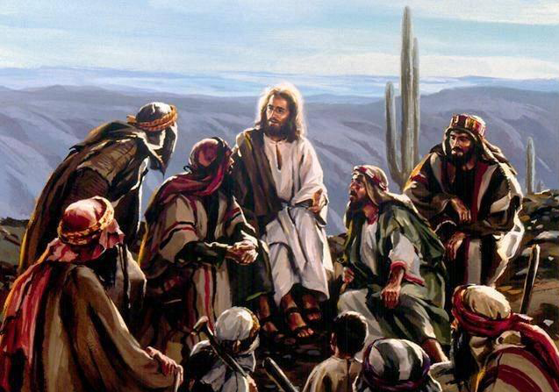
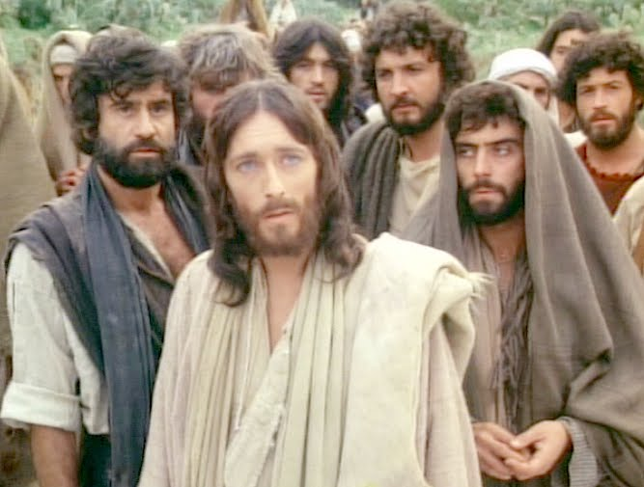
HOW IS THE CHURCH SANCTIFIED?
Heb 2:11: (NASV) “For both He who sanctifies and those who are sanctified are all from one Father; for which reason He is not ashamed to call them brethren…”
Notes:
[Read Heb 2:11] “Father” is in italics and is added by the confused translators.

Slide 48
HOW IS THE CHURCH SANCTIFIED?
Heb 2:11: (NASV) “For both He who sanctifies and those who are sanctified are all from one Father; for which reason He is not ashamed to call them brethren…”
Heb 2:11: “are all of one.”
Heb 10:9: “then He said, “BEHOLD, I HAVE COME TO DO YOUR WILL…”
Rom 12:1 (NASV) “present your bodies a living and holy sacrifice”
Notes:
The text should read “are all of one.” Yes, the church is offered up together as part of THE CHRIST, head and body. We are “all of one,” that is all of one body. [press ENTER] We all say together “I have come to do your will oh God” [press ENTER] to present our bodies in sacrifice (Rm 12:1), which SANCTIFIES our character to be holy.

Slide 49
HOW IS THE CHURCH SANCTIFIED?
Heb 2:11: (NASV) “For both He who sanctifies and those who are sanctified are all from one Father; for which reason He is not ashamed to call them brethren…”
Heb 2:11: “are all of one.”
Heb 10:9: “then He said, “BEHOLD, I HAVE COME TO DO YOUR WILL…”
Rom 12:1 (NASV) “present your bodies a living and holy sacrifice”
Notes:
The “bodies” of Romans 12:1 can NOT be ONLY Jesus, since His “offering” of Himself alone SANCTIFIED only himself, (even though His offering of Himself alone JUSTIFIED the Church -- justification is not the point here). Hebrews 2:11 is NOT talking about JUSTIFICATION. If it were, then it would be true that Jesus offering “JUSTIFIES” us. But the text is referring to “SANCTIFICATION.” Jesus sacrifice of Himself alone does NOT SANCTIFY the Church.

Slide 50
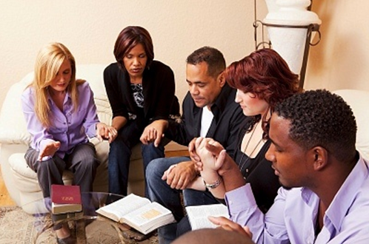
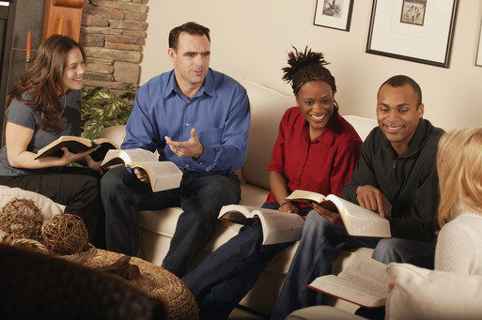
HOW IS THE CHURCH SANCTIFIED?
Heb 10:14 (NASV) “For by one offering He has perfected for all time those who are sanctified”
Notes:
Rather, the joint offering (including the offering of the Church) SANCTIFIES the Church. [Read Heb 10:14] This one joint offering (of Christ and the Church) PERFECTS our CHARACTER and SANCTIFIES the Church, just as Jesus character was perfected through his own sufferings (Heb 2:10; 5:8, 9)]

Slide 51
DOES HEBREWS 8 SHOW US WHEN THE NEW COVENANT IS MADE?
Hebrews 8:1, 7-8 (NASV) “1 Now the main point in what has been said is this: we have such a high priest… 7… For if that first covenant [priesthood] had been faultless… 8 For finding fault with them, he saith…”
Hebrews 7:11 (NASV) “11 ¶ Now if there was perfection through the Levitical priesthood… what further need was there that another priest should arise after the order of Melchizedek, and not be reckoned after the order of Aaron?”
FAULT WITH LEVITICAL PRIESTHOOD, NOT WITH PERFECT LAW COVENANT
Notes:
[Read Question and Heb 8:1, 7-8] In Heb 8:1, Paul says that the main point is that Jesus is our high priest. In contrast in verse 8 God found “fault with them,” the Levitical priesthood. God is replacing the Levitical priesthood with a new (Melchizedek) priesthood (Jesus and the Church). [press ENTER, read Heb 7:11] Hebrews 7:11 shows that Jesus’ Priesthood was necessary because the Levitical priesthood could not bring perfection. Hence, God found fault with that priesthood.

Slide 52
DOES HEBREWS 8 SHOW US WHEN THE NEW COVENANT IS MADE?
Hebrews 8:9-10 (ASV) “9 Not according to the covenant that I made with their fathers In the day that I took them by the hand to lead them forth out of the land of Egypt; For they continued not in my covenant, And I regarded them not, saith the Lord. 10 For this is the covenant that I will make with the house of Israel after those days, saith the Lord; I will put my laws into their mind, And on their heart also will I write them: And I will be to them a God, And they shall be to me a people…”
Notes:
[Read Heb 8:9-10] Because God found fault with the first priesthood, in Hebrews 8:10 He says He will make a New Covenant with Israel “after those days”; that is, after the days of vs 9, when He says, “I regarded them not.” The New Covenant could not have begun at the time of the Apostles since it is to begin after the days that that He “regarded them not” (that is after the end of Israel’s period of disfavour which spanned most of the Gospel Age).]

Slide 53
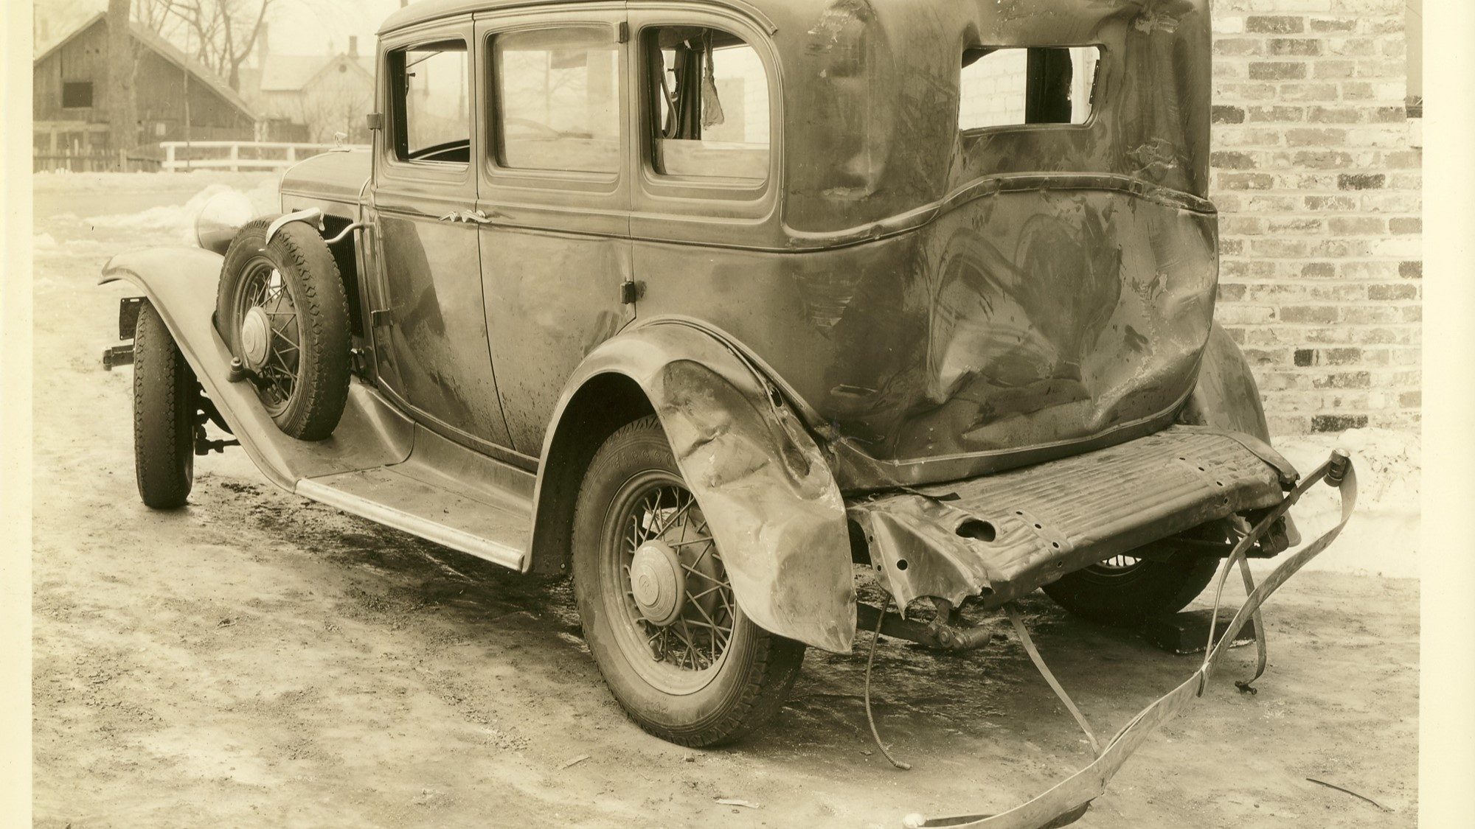
DOES HEBREWS 8 SHOW US WHEN THE NEW COVENANT IS MADE?
Hebrews 8:13 (NASV) “When He said, "A new covenant," He has made the first obsolete. But whatever is becoming obsolete and growing old is ready to disappear..."
Notes:
[Read Heb 8:13] Since in Paul's day the Old Law Covenant had not yet vanished away, the New Covenant could not yet have been established. The shadow (type) ends where the reality (antitype) begins. (Matt 5:17-18; Heb 10:1) The Law Covenant is a shadow of things to come. When it has fully passed away, only then can the New Covenant go into operation. Hebrews 8 shows us the New Covenant is future.

Slide 54
DOES HEBREWS 10 SHOW US WHEN THE NEW COVENANT IS MADE?
Hebrews 10:14-18 (Wilson’s Diaglott)
“14 By one offering he has perfected for the continuance those being sanctified. 15 Testifies but to us also the spirit the holy. After for that to have said before; 16 this the covenant, which I will ratify to them after the days those; says a Lord: Giving laws of me in hearts of them, and on the minds of them I will write them, 17 and of the sins of them and of the iniquities of them not I may remember more. 18 Where now forgiveness of these, no longer offering for sin.”
Notes:
[Read Question and verses] Most translators totally ruin these verses because the translators have no concept of the Church's share in the joint sacrifice ratifying the New Covenant. The word "AFTER" of verse 15, is referring to the word "AFTER" in the Jer 31 prophecy, showing that the New Covenant comes AFTER Israel's period of disfavor, when God "regarded them not" (Heb 10:9). This period of disfavor would begin 33 A.D. when Jesus said "your house is left to your desolate."

Slide 55
DOES HEBREWS 10 SHOW US WHEN THE NEW COVENANT IS MADE?
Hebrews 10:14-18 (Wilson’s Diaglott)
“14 By one offering he has perfected for the continuance those being sanctified. 15 Testifies but to us also the spirit the holy. After for that to have said before; 16 this the covenant, which I will ratify to them after the days those; says a Lord: Giving laws of me in hearts of them, and on the minds of them I will write them, 17 and of the sins of them and of the iniquities of them not I may remember more. 18 Where now forgiveness of these, no longer offering for sin.”
Notes:
Some brethren have also thought that Paul in Heb 10:15 is referring to AFTER the offering in sacrifice of the Church during the Gospel Age mentioned in Heb 10:14. Either approach shows that the New Covenant will not go into effect until the time when either God is ready to fully "regard" Israel and/or after the Church's sacrifice is complete (both interpretations place the operation of the New Covenant future).

Slide 56
DOES HEBREWS 10 SHOW US WHEN THE NEW COVENANT IS MADE?
Hebrews 10:14-18 (Wilson’s Diaglott)
“14 By one offering he has perfected for the continuance those being sanctified. 15 Testifies but to us also the spirit the holy. After for that to have said before; 16 this the covenant, which I will ratify to them after the days those; says a Lord: Giving laws of me in hearts of them, and on the minds of them I will write them, 17 and of the sins of them and of the iniquities of them not I may remember more. 18 [Then He says] Where now forgiveness of these, no longer offering for sin.”
Notes:
Most translators attempt to connect the word "AFTER" in Heb 10:15 with the spurious words "He then says" in verse 18 to confuse the meaning by implying that the New Covenant is for the Church. These translators arbitrarily create these spurious words “Then He says" in verse 18.

Slide 57
DOES HEBREWS 10 SHOW US WHEN THE NEW COVENANT IS MADE?
Hebrews 10:14-18 (Wilson’s Diaglott)
“14 By one offering he has perfected for the continuance those being sanctified. 15 Testifies but to us also the spirit the holy. After for that to have said before; 16 this the covenant, which I will ratify to them after the days those; says a Lord: Giving laws of me in hearts of them, and on the minds of them I will write them, 17 and of the sins of them and of the iniquities of them not I may remember more. 18 Where now forgiveness of these, no longer offering for sin.”
Notes:
Once we remove these spurious words, the only way to make any sense of the passage is with one of the two suggestions we made for the word "AFTER,” either after Israel’s period of disfavor or after the sacrifice of the Church is complete. Hebrews 10 shows that the New Covenant is made in the future.

Slide 58

HOW ARE COVENANTS PICTURED BY ABRAHAM’S WIVES?
Two observations from Galatians
Words “New Covenant” not found
Law Covenant and Abrahamic Covenant explicitly discussed
Gal 4:21 (NASV) "Tell me, you who want to be under law, do you not listen to the law?"
Notes:
[Read question] We find our answer in Galatians 4 and would like to begin by noting two observations: ►
1) Nowhere in Galatians does Paul mention the expression "New Covenant."
Paul explicitly mentions both the Law Covenant and the Abrahamic Covenant and begins that discussion in chapter 3. ►
Read Galatians 4:21

Slide 59
HOW ARE COVENANTS PICTURED BY ABRAHAM’S WIVES?
Two observations from Galatians
Words “New Covenant” not found
Law Covenant and Abrahamic Covenant explicitly discussed
Gal 4:21 (NASV) "Tell me, you who want to be under law, do you not listen to the law?"
Notes:
Notice that Paul explicitly mentions the Law Covenant here. Also, remember that some in the Early Church felt they were still under the Law Covenant. So why doesn't Paul simply tell them that they can't be under the Law Covenant, because now they are under the New Covenant? If in Paul's day the Church were already under the New Covenant, this would have been the obvious place to present that argument.

Slide 60

Galatians 4 (NASV)
“22 For it is written that Abraham had two sons, one by the bondwoman and one by the free woman.
23 But the son by the bondwoman was born according to the flesh, and the son by the free woman through the promise.
24 This is allegorically speaking, for these women are two covenants: one proceeding from Mount Sinai bearing children who are to be slaves; she is Hagar.
25 Now this Hagar is Mount Sinai in Arabia and corresponds to the present Jerusalem, for she is in slavery with her children.”
Notes:
Let’s read further in Galatians 4.
[Read verses]
Vs 24 clearly states that Hagar and Sarah represent two covenants. Only two covenants are discussed in Galatians, not three.

Slide 61
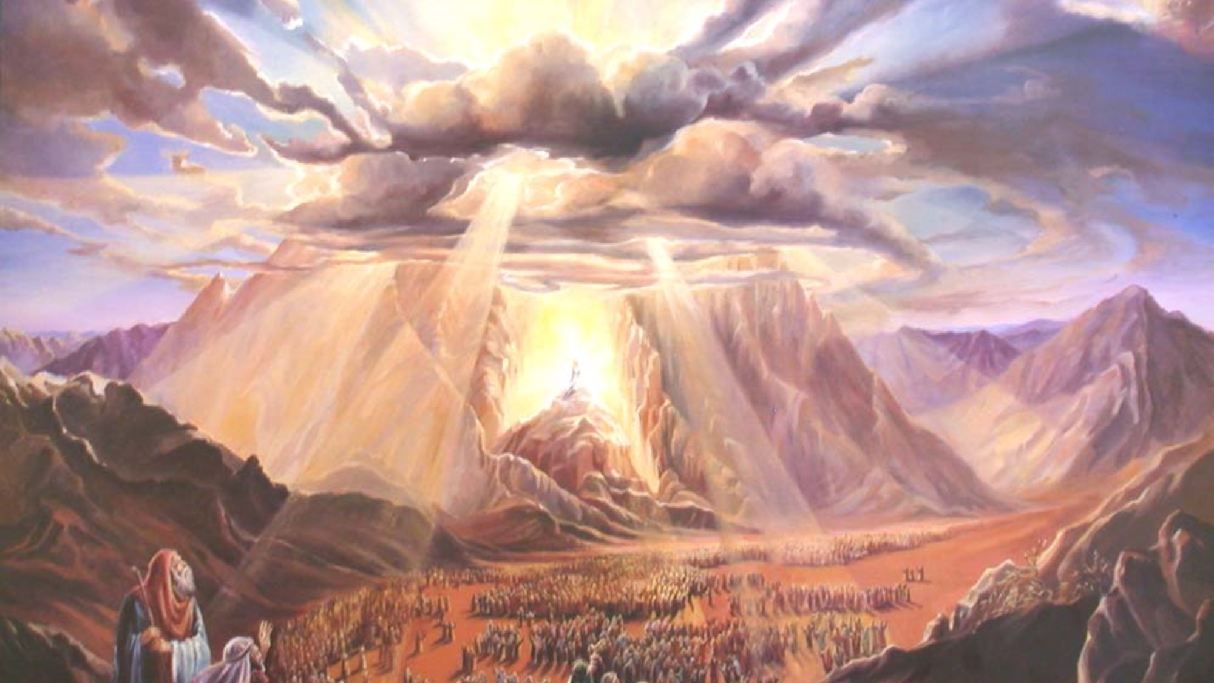
WHAT COVENANT DOES HAGAR REPRESENT?
Galatians 4:25 (NASV) “Now this Hagar is Mount Sinai in Arabia and corresponds to the present Jerusalem, for she is in slavery with her children.”
Hagar = Law Covenant Ishmael = Natural Israel
Galatians 3:19 (NASV) “Why the Law then? It was added because of transgressions…”
Notes:
In verse 25, the covenant from Mount Sinai is clearly the Law Covenant. So, Hagar represents the Law Covenant. Ishmael, her son, represents natural Israel. [Read Galatians 3:19]
Gal 3:19 tells us that the Law was "added" to the Abrahamic Covenant. Hagar was "added" to Abraham's family, illustrating that the Law was "added" to the Abrahamic Covenant.

Slide 62
WHAT COVENANT DOES HAGAR REPRESENT?
Galatians 4:25 (NASV) “Now this Hagar is Mount Sinai in Arabia and corresponds to the present Jerusalem, for she is in slavery with her children.”
Hagar = Law Covenant Ishmael = Natural Israel
Galatians 3:19 (NASV) “Why the Law then? It was added because of transgressions…”
Notes:
Hagar's son was born first and represents how the Jewish people (natural Israel) were the first that came into the inheritance under God's favor.
Notice how verse 25 says "she is in slavery with her children." So even though in Paul's day the Law Covenant was dying, the Jews were still in slavery, under that Law Covenant. Hagar (the Law) was still with Ishmael (natural Israel).

Slide 63
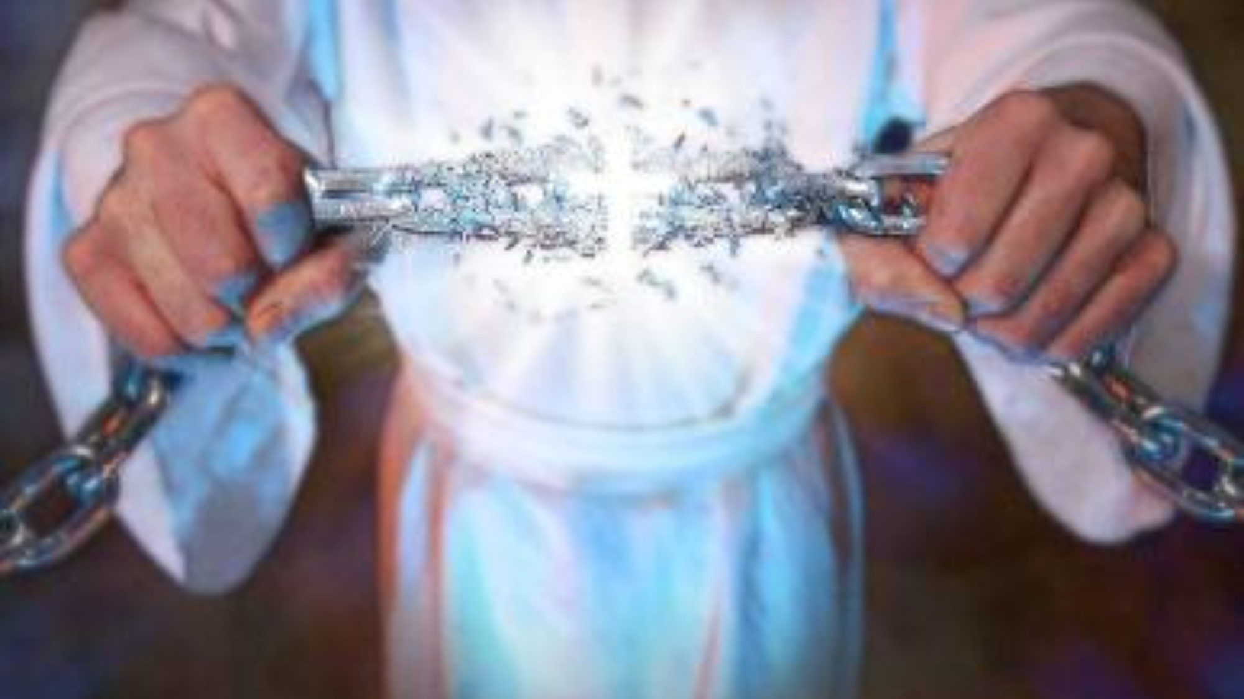
COME OUT FROM THE LAW TO COME INTO CHRIST
Rom 7 (NASV) “4... you also were made to die to the Law through the body of Christ, 6 But now we have been released from the Law, having died to that by which we were bound…”
Rom 10:4 (NASV) “For Christ is the end of the law for righteousness to everyone who believes.”
Notes:
Paul shows that the Jews were still under the Law Covenant in his day by explaining in Romans that that in order to come into Christ, they had to come out from under the Law Covenant.
[Read two verses above]
So Paul explains that in order for the Jews to come out from under the Law, they had to come into Christ.

Slide 64
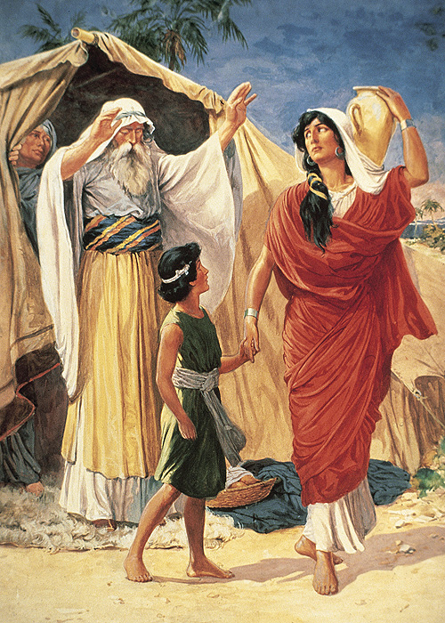
Galatians 4 (NASV) “29 But as at that time he who was born according to the flesh persecuted him who was born according to the Spirit, so it is now also. 30 But what does the Scripture say? "CAST OUT THE BONDWOMAN AND HER SON, FOR THE SON OF THE BONDWOMAN SHALL NOT BE AN HEIR WITH THE SON OF THE FREE WOMAN.“”
Notes:
[Read verses]
When Hagar was cast out, she took her son Ishmael with her, showing that during their period of disfavor, Israel has remained in bondage, under that dying Law Covenant, and will continue under the Law until the New Covenant replaces it.

Slide 65
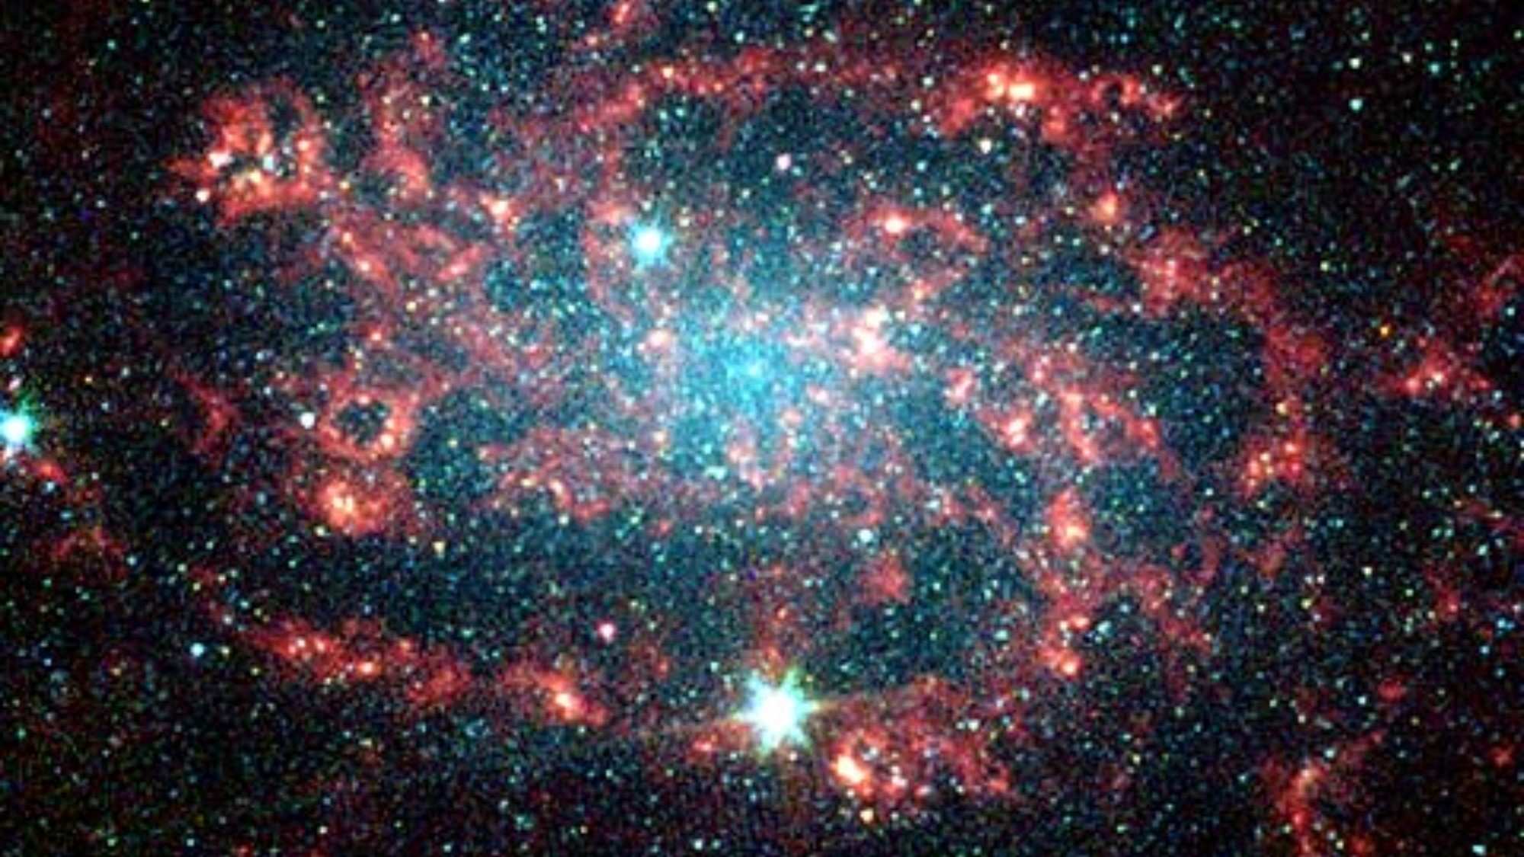
WHAT COVENANT DOES SARAH REPRESENT?
Galalatians 4 (NASV) “26 But the Jerusalem above is free; she is our mother. 27 For it is written, "REJOICE, BARREN WOMAN WHO DOES NOT BEAR; BREAK FORTH AND SHOUT, YOU WHO ARE NOT IN LABOR; FOR MORE NUMEROUS ARE THE CHILDREN OF THE DESOLATE THAN OF THE ONE WHO HAS A HUSBAND." 28 And you brethren, like Isaac, are children of promise.”
Notes:
[Read screen]
Let’s consider three lines of evidence that Sarah is represented by the Abrahamic Covenant, not the New Covenant.

Slide 66
WHAT COVENANT DOES SARAH REPRESENT?
Galalatians 4 (NASV) “26 But the Jerusalem above is free; she is our mother. 27 For it is written, "REJOICE, BARREN WOMAN WHO DOES NOT BEAR; BREAK FORTH AND SHOUT, YOU WHO ARE NOT IN LABOR; FOR MORE NUMEROUS ARE THE CHILDREN OF THE DESOLATE THAN OF THE ONE WHO HAS A HUSBAND." 28 And you brethren, like Isaac, are children of promise.”
Psalms 50:5 (NKJV) "Gather My saints together to Me, Those who have made a covenant with Me by sacrifice."
Notes:
1) Here Sarah is associated with Abrahamic Covenant and her son Isaac is The Christ, Head and Body, heirs of the promise--through whom all families of the earth are to be blessed. The Church is developed under the same Covenant-Mother as was Jesus; the Sarah Covenant, also referred to as the Grace Covenant ► and a Covenant of sacrifice. (Psa 50:5).

Slide 67
WHAT COVENANT DOES SARAH REPRESENT?
Galalatians 4 (NASV) “26 But the Jerusalem above is free; she is our mother. 27 For it is written, "REJOICE, BARREN WOMAN WHO DOES NOT BEAR; BREAK FORTH AND SHOUT, YOU WHO ARE NOT IN LABOR; FOR MORE NUMEROUS ARE THE CHILDREN OF THE DESOLATE THAN OF THE ONE WHO HAS A HUSBAND." 28 And you brethren, like Isaac, are children of promise.”
Notes:
2) As Sarah was older than Hagar, but barren for many years, so the primary, or chief, Covenant of God was barren for nearly two thousand years and only began to bring forth the seed of promise in Jesus' resurrection from the dead and also in the begetting of the entire Church by the holy Spirit. The antitypical son of Sarah has already been more than nineteen centuries in process of development.

Slide 68
WHAT COVENANT DOES SARAH REPRESENT?
Galalatians 4 (NASV) “26 But the Jerusalem above is free; she is our mother. 27 For it is written, "REJOICE, BARREN WOMAN WHO DOES NOT BEAR; BREAK FORTH AND SHOUT, YOU WHO ARE NOT IN LABOR; FOR MORE NUMEROUS ARE THE CHILDREN OF THE DESOLATE THAN OF THE ONE WHO HAS A HUSBAND." 28 And you brethren, like Isaac, are children of promise.”
Notes:
After the Sarah Covenant has finished its travailing, and has fully brought forth the Isaac class (the Church), then the New Covenant will be established with Israel.

Slide 69
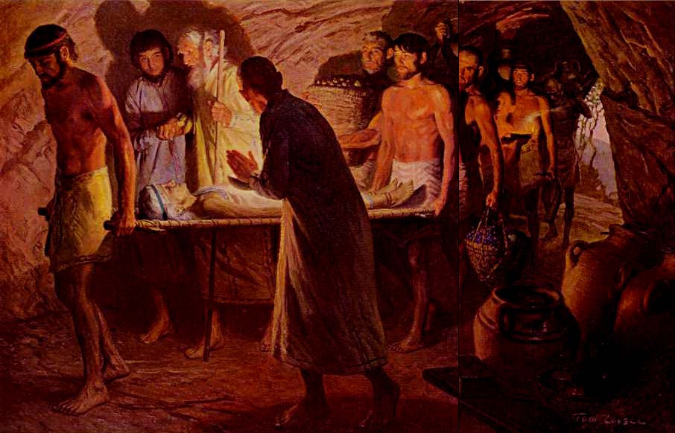
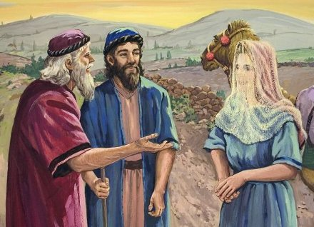
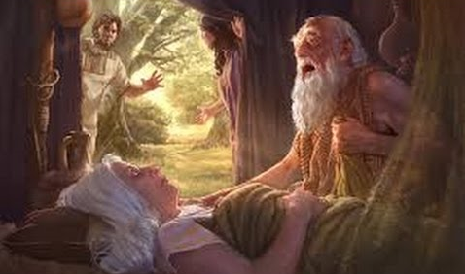
Notes:
3) In the type Sarah died prior to the time that Isaac married Rebecca. Sarah’s death signifies that the Abrahamic Covenant's purpose of developing the spiritual seed will have already been accomplished once the Church is complete and joined with Jesus, her Bridegroom. This Seed of Abraham, bride and bridegroom, will then be ready to bless all people. Then, the Church will be aided by a third covenant that was added, the New Covenant.

Slide 70
SARAH REPRESENTS THE ABRAHAMIC COVENANT, NOT THE NEW COVENANT
Jesus body members are developed under the same Covenant-Mother as was Jesus
As Sarah was older than Hagar, but barren, so the Abrahamic Covenant was older than Law Covenant, but barren for nearly 2,000 years before beginning to produce it’s seed.
As Isaac married Rebecca after Sarah died, so the Heavenly marriage is fully accomplished after the Abrahamic Covenant has completed its work of developing the spiritual seed.
Notes:
To summarize [Read screen]

Slide 71
SARAH REPRESENTS THE ABRAHAMIC COVENANT, NOT THE NEW COVENANT
Jesus body members are developed under the same Covenant-Mother as was Jesus
As Sarah was older than Hagar, but barren, so the Abrahamic Covenant was older than Law Covenant, but barren for nearly 2,000 years before beginning to produce it’s seed.
As Isaac married Rebecca after Sarah died, so the Heavenly marriage is fully accomplished after the Abrahamic Covenant has completed its work of developing the spiritual seed.

Slide 72
SARAH REPRESENTS THE ABRAHAMIC COVENANT, NOT THE NEW COVENANT
Jesus body members are developed under the same Covenant-Mother as was Jesus
As Sarah was older than Hagar, but barren, so the Abrahamic Covenant was older than Law Covenant, but barren for nearly 2,000 years before beginning to produce it’s seed.
As Isaac married Rebecca after Sarah died, so the Heavenly marriage is fully accomplished after the Abrahamic Covenant has completed its work of developing the spiritual seed.

Slide 73
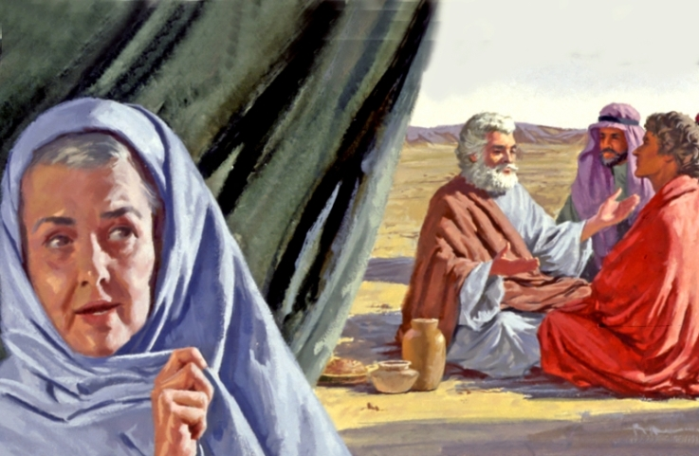
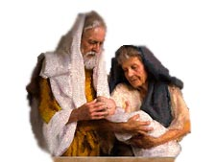
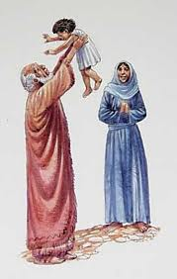
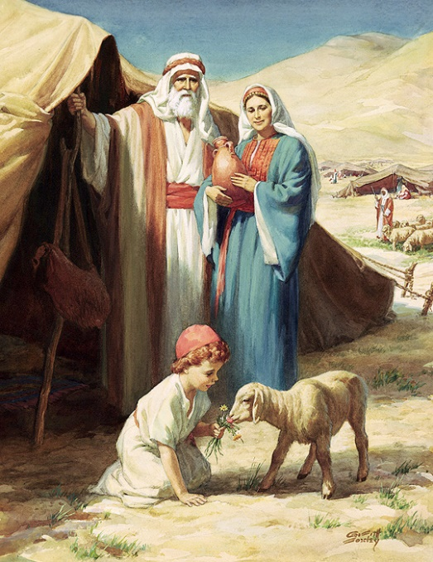
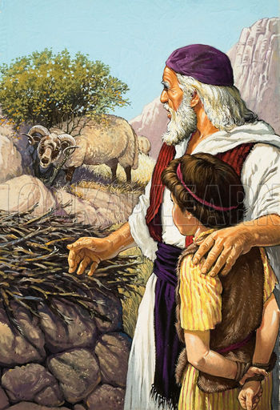
WHY DO WE ASSOCIATE THE SARAH COVENANT WITH SPIRITUAL ISRAEL?
Galatians 4:28 (NASV) “And you brethren, like Isaac, are children of promise. 29 But as at that time he who was born according to the flesh persecuted him who was born according to the Spirit, so it is now also.”
Notes:
[Read question] We often call the Sarah Covenant, the "Grace Covenant" or the "Covenant of Sacrifice." It is that portion of the Abrahamic Covenant that relates to the spiritual seed, the bride of Christ. How do we know this? [Read Galatians 4:28-29]
In verse 28, Paul says that we are “children of promise.”

Slide 74
WHY DO WE ASSOCIATE THE SARAH COVENANT WITH SPIRITUAL ISRAEL?
Galatians 4:28 (NASV) “And you brethren, like Isaac, are children of promise. 29 But as at that time he who was born according to the flesh persecuted him who was born according to the Spirit, so it is now also.”
Galatians 4 (NASV) “23 But the son by the bondwoman [Hagar] was born according to the flesh, and the son by the free woman [Sarah] through the [Abrahamic] promise.”
Notes:
In verse 29, the expression, "him who was born according to the Spirit," identifies the “heirs (or children) of promise” (press ENTER, of the Abrahamic promise of verse 23) as the spiritual seed of the Abrahamic Covenant. Therefore, Sarah pictures that part of the Abrahamic Covenant relating to the spiritual seed. We refer to it as the “stars of heaven” part.

Slide 75
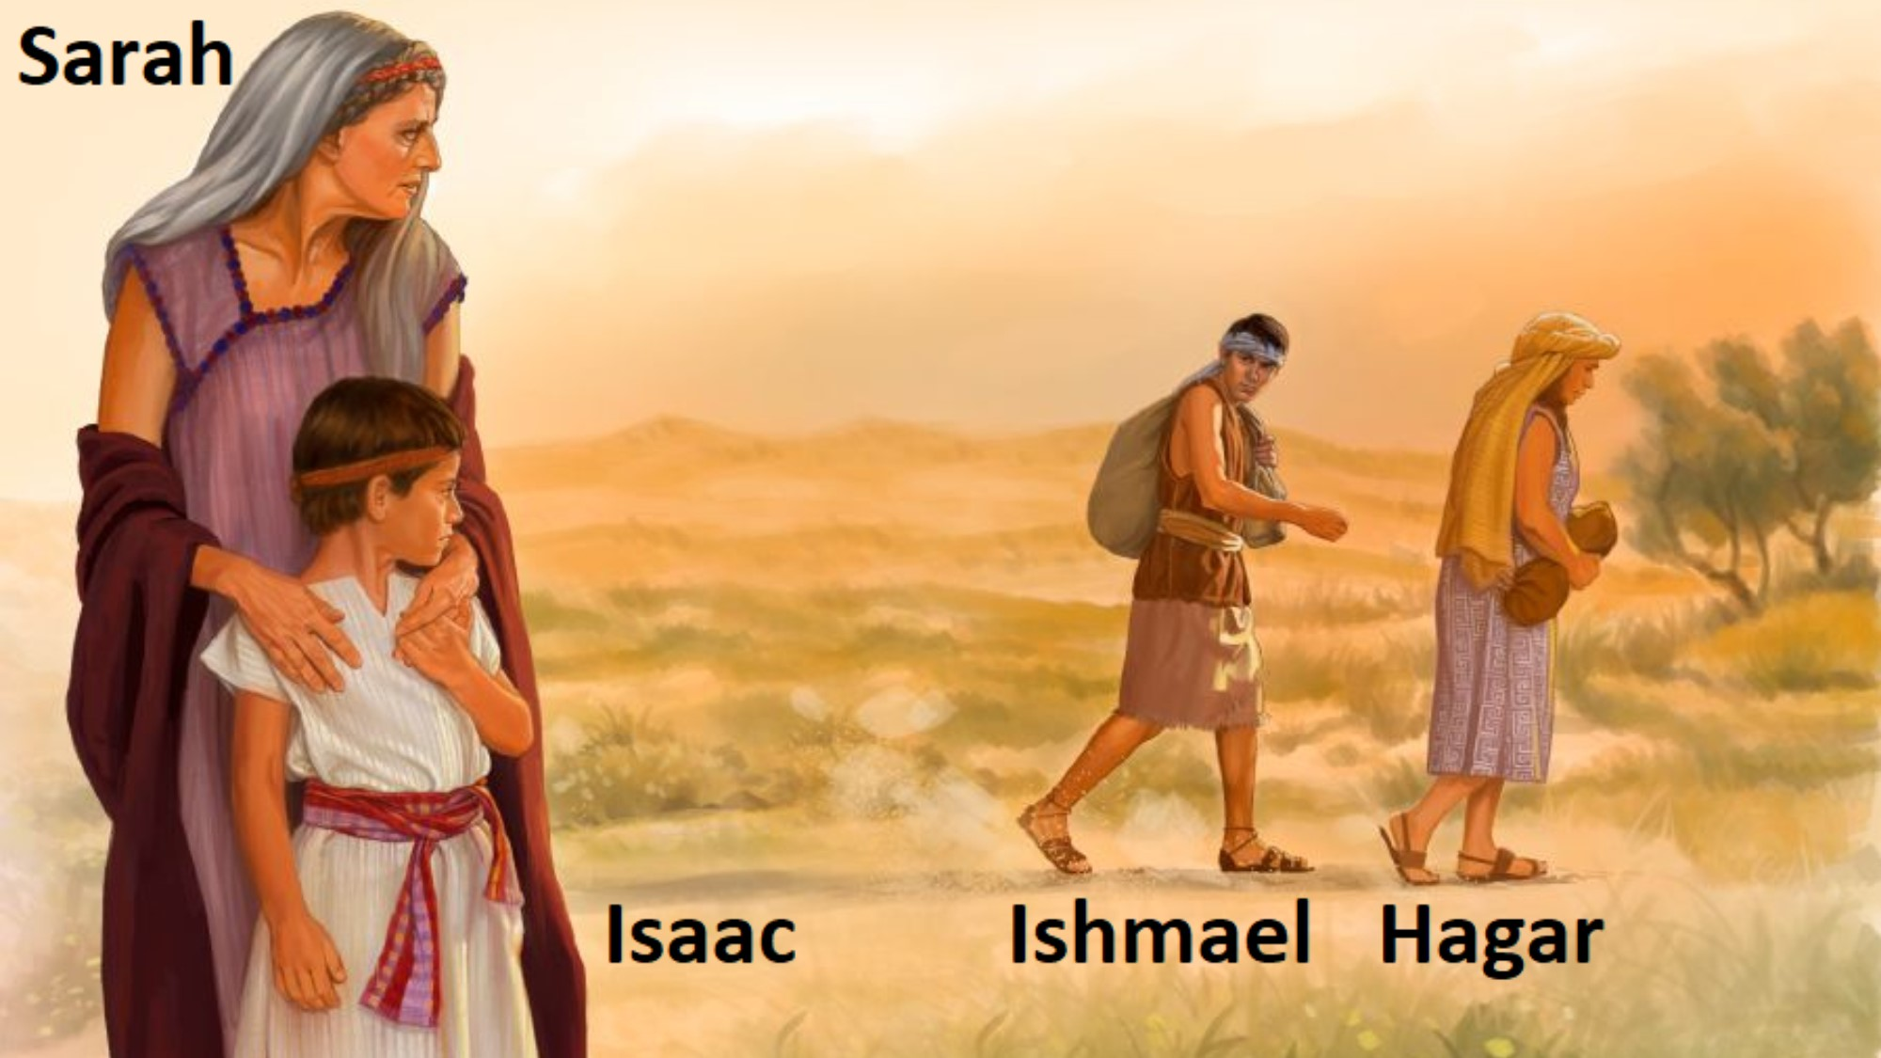
WHY CANNOT SARAH REPRESENT THE NEW COVENANT?
1. Galatians 3:24 (NKJV) “These women are two covenants”
Notes:
[Read question] We will suggest four reasons. First, remember that Gal 4:24 says, “these women are two covenants.” If Sarah and Hagar each represent the Abrahamic and Law Covenants respectively, then Sarah cannot also represent the New Covenant or you would have two women representing three covenants. This would contradict Paul’s clear statement, “these women are two covenants.”

Slide 76
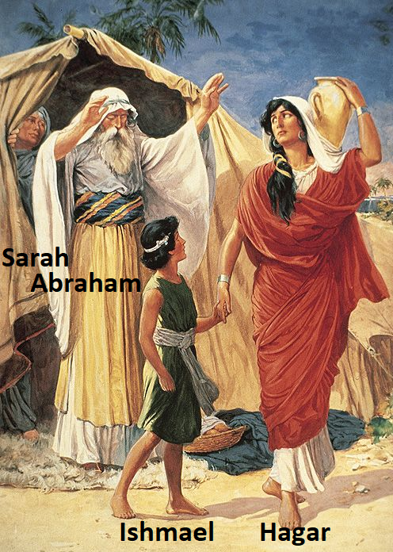
WHY CAN’T SARAH REPRESENT THE NEW COVENANT?
Oldest covenant is FIRST wife.
FIRST Sarah - ABRAHAMIC
SECOND Hagar - LAW
THIRD Keturah - NEW
Notes:
Second reason: The Abrahamic Covenant, pictured by Sarah, cannot be considered a New Covenant, since it is the oldest of the three covenants. The New Covenant will follow the Old Law Covenant which it replaces. It is the final covenant that follows both the Abrahamic and Law Covenants. Hence it is the newest covenant.

Slide 77
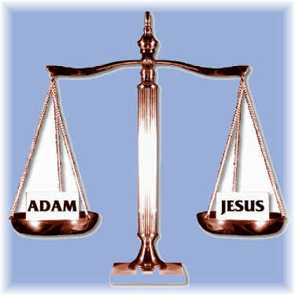
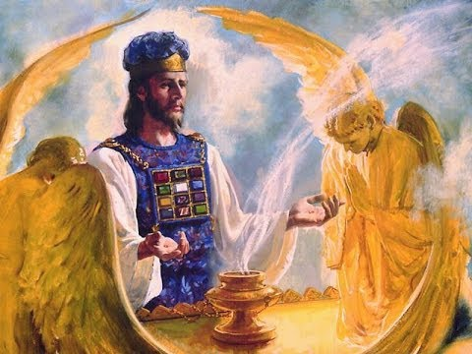
WHY CAN’T SARAH REPRESENT THE NEW COVENANT?
Hebrews 7:26 (NKJV) “For such a High Priest was fitting for us, who is holy, harmless, undefiled, separate from sinners…”
Perfect Jesus did not need any benefits the New
Covenant provided
Notes:
Third reason: Sarah cannot represent the New Covenant, since the Isaac class, the spiritual seed, head and body, is NOT under that covenant. Jesus as the New Covenant’s Mediator (Hebrew 9:15) and as head of the body, did not need forgiveness of sins nor anything else the New Covenant of Jeremiah 31 could provide. Hence since Jesus the head is NOT under the New Covenant, neither are His body members.

Slide 78
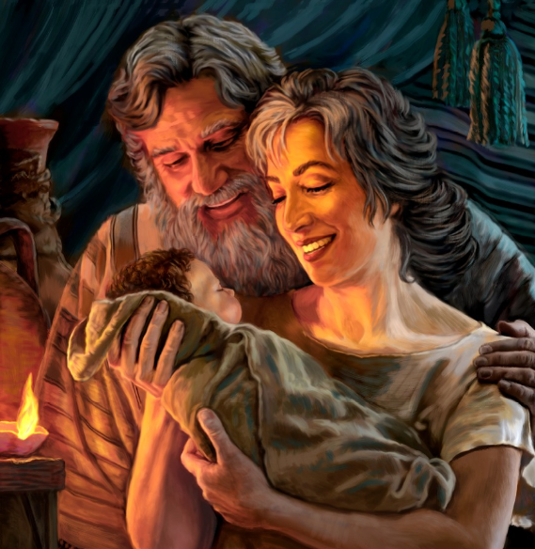
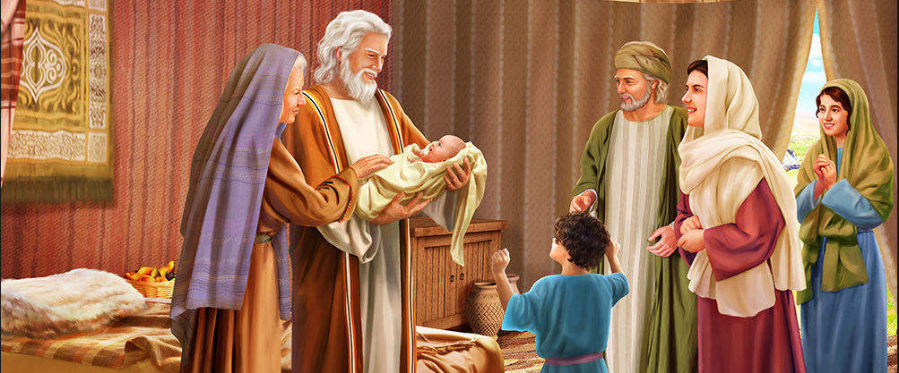
WHY CAN’T SARAH REPRESENT THE NEW COVENANT?
Gal 4:28-29 (NKJV) “we, brethren, as Isaac was, are children of promise… who was born according to the Spirit…”
Gal 4:23 (Amplified) “…the son of the free woman was born in fulfillment of the promise.”
Notes:
Fourth reason: [Read verses] In Galatians 4:29, the expression, "him who was born according to the Spirit," identifies the “children of [the Abrahamic] promise” as the spiritual seed of the Abrahamic Covenant. Clearly Paul placed the Church under the Abrahamic Covenant. This promise to Abraham was the older covenant and hence cannot be called a “New Covenant.”

Slide 79
WHY CAN’T SARAH REPRESENT THE NEW COVENANT?
Galatians 4:24 “these women are two covenants” (not three covenants). They are the Abrahamic and Law covenants.
Sarah would picture the older covenant, since she was a wife before both Hagar and Keturah.
Sarah’s son Isaac is the Christ, head and body. Jesus cannot be under the New Covenant, as he does not need forgiveness of sins or anything else the Jeremiah 31 covenant has to offer.
The “promise” (Gal 4:23) to Abraham was the older covenant and hence cannot be called a “New Covenant.”

Slide 80
WHY CAN’T SARAH REPRESENT THE NEW COVENANT?
Galatians 4:24 “these women are two covenants” (not three covenants). They are the Abrahamic and Law covenants.
Sarah would picture the older covenant, since she was a wife before both Hagar and Keturah.
Sarah’s son Isaac is the Christ, head and body. Jesus cannot be under the New Covenant, as he does not need forgiveness of sins or anything else the Jeremiah 31 covenant has to offer.
The “promise” (Gal 4:23) to Abraham was the older covenant and hence cannot be called a “New Covenant.”

Slide 81
WHY CAN’T SARAH REPRESENT THE NEW COVENANT?
Galatians 4:24 “these women are two covenants” (not three covenants). They are the Abrahamic and Law covenants.
Sarah would picture the older covenant, since she was a wife before both Hagar and Keturah.
Sarah’s son Isaac is the Christ, head and body. Jesus cannot be under the New Covenant, as he does not need forgiveness of sins or anything else the Jeremiah 31 covenant has to offer.
The “promise” (Gal 4:23) to Abraham was the older covenant and hence cannot be called a “New Covenant.”

Slide 82
WHY CAN’T SARAH REPRESENT THE NEW COVENANT?
Galatians 4:24 “these women are two covenants” (not three covenants). They are the Abrahamic and Law covenants.
Sarah would picture the older covenant, since she was a wife before both Hagar and Keturah.
Sarah’s son Isaac is the Christ, head and body. Jesus cannot be under the New Covenant, as he does not need forgiveness of sins or anything else the Jeremiah 31 covenant has to offer.
The “promise” (Gal 4:23) to Abraham was the older covenant and hence cannot be called a “New Covenant.”

Slide 83
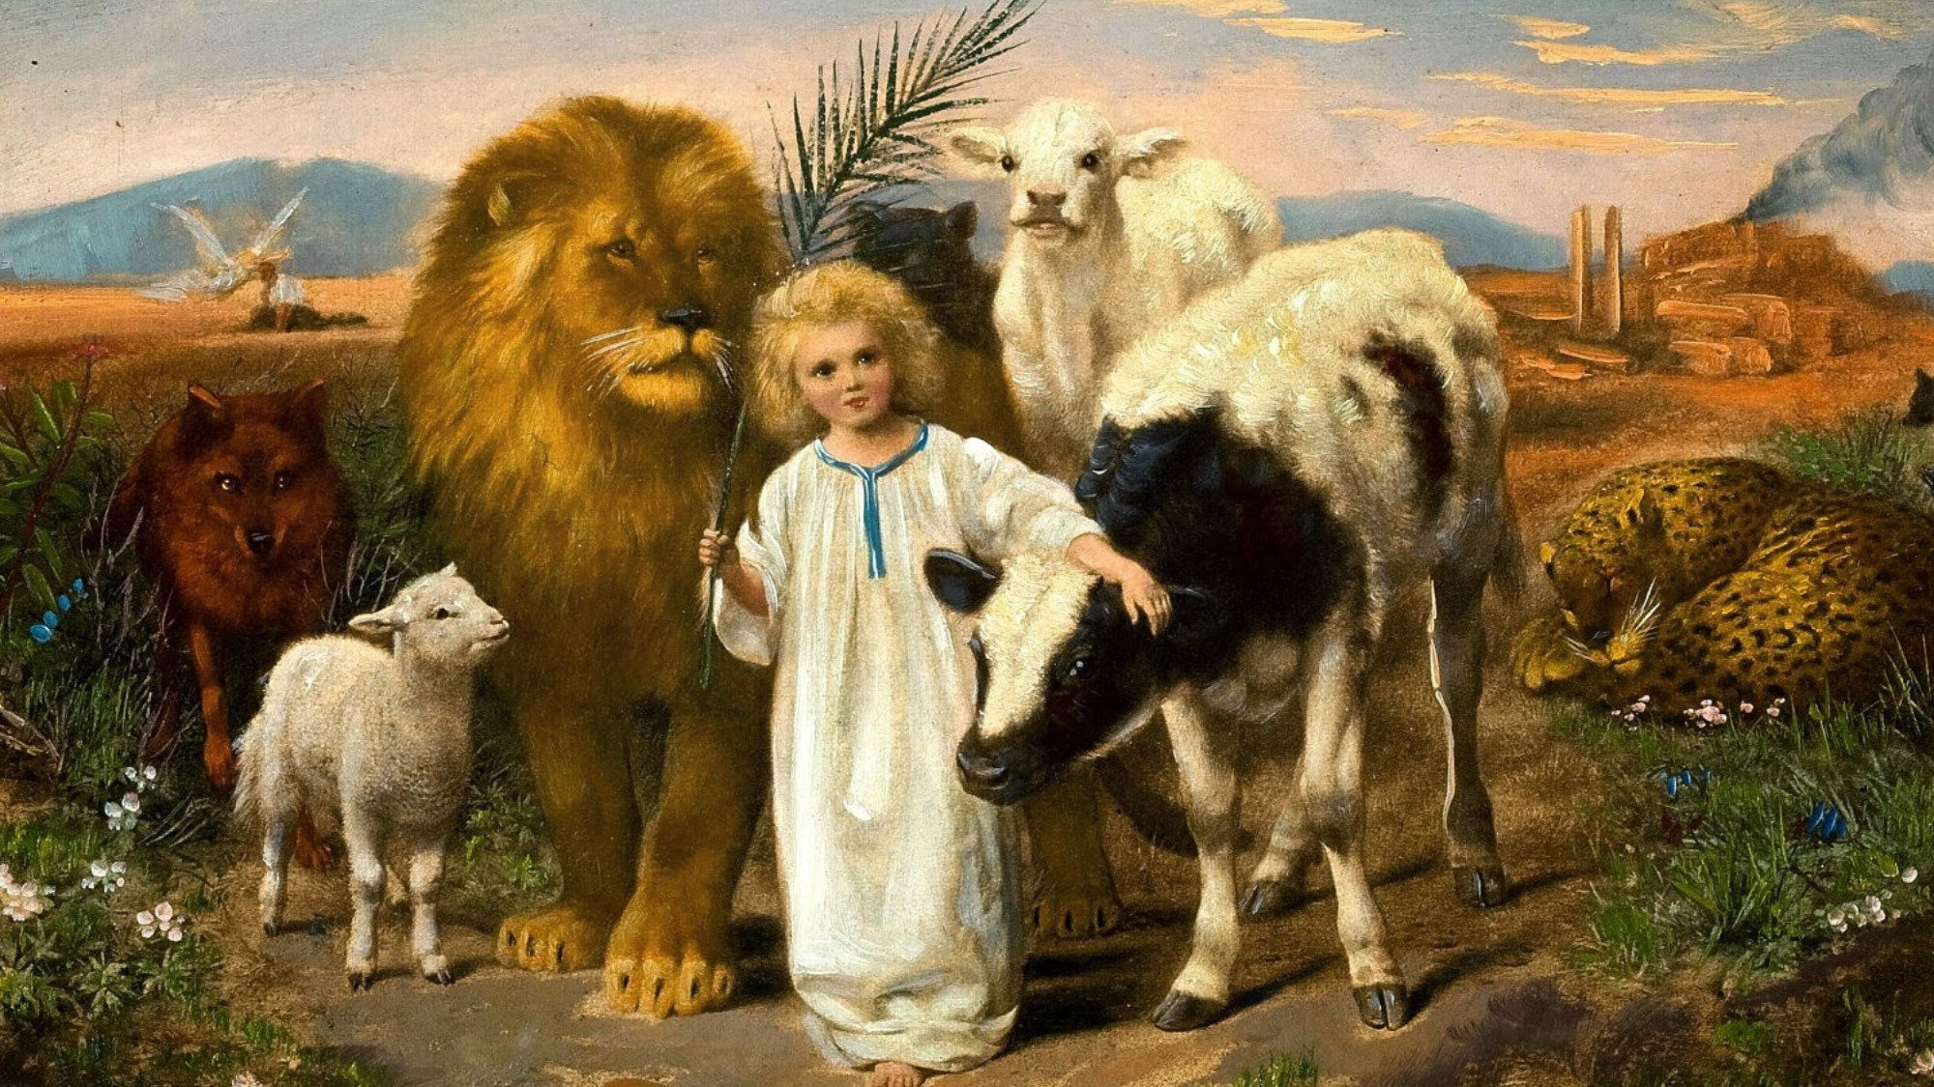
WHO RESPRESENTS THE NEW COVENANT?
R5300 “…all the families of the earth will be brought to human perfection through Restitution processes, as children of the Keturah, or New Covenant.”
Notes:
[Read R5300]

Slide 84
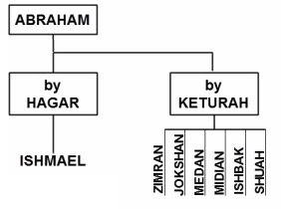
WHO RESPRESENTS THE NEW COVENANT?
R4371 “the New Covenant (Keturah) bears six sons, which, taken with the one of Hagar would be seven—a complete number—representing that all the fleshly children would be developed under the Hagar and Keturah or "Law" and "New" Covenants.”
Notes:
[Read R4371]

Slide 85
THREE REASONS KETURAH IS THE NEW COVENANT.
1. Abraham married Keturah after Sarah died.
Notes:
We will suggest three reasons why Keturah represents the New Covenant:
1) Abraham married Keturah (Gen 25) after Sarah died (Gen 23), showing that the New Covenant begins after the Abrahamic Covenant has completed its purpose of developing the spiritual seed.

Slide 86
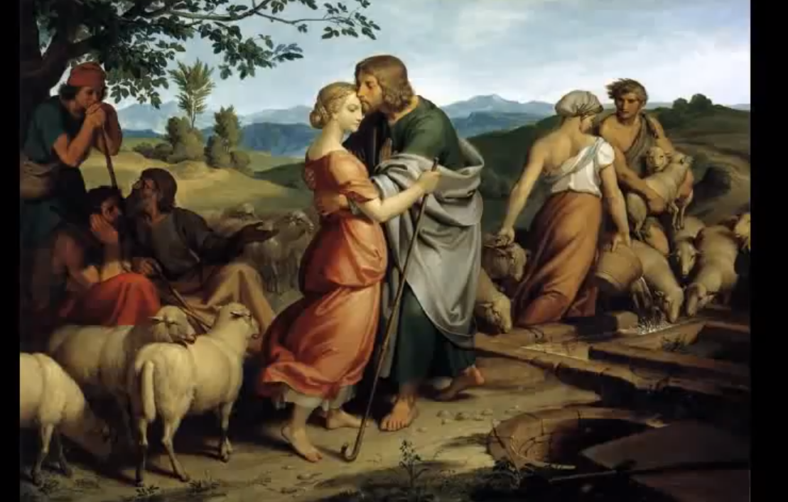
THREE REASONS KETURAH IS THE NEW COVENANT.
Hagar
Abraham
2. Sarah did not have a second son to picture the earthly class
Notes:
Reason # 2 why Keturah represents the New Covenant is that Sarah never had a second son to picture the earthly class under the New Covenant. Sarah could not picture the New Covenant since she already pictured the Abrahamic Covenant. There would be a new wife or concubine, Keturah, to picture the New Covenant. This was the simplest way God could present these covenants in type.

Slide 87

THREE REASONS KETURAH IS THE NEW COVENANT.
Isaac
Rebekah
3: Keturah became Abraham’s wife after Isaac married Rebekah
Notes:
Reason 3 why Keturah represents the New Covenant: Just as Keturah became Abraham’s wife (or concubine) after Isaac married Rebekah, so the New Covenant goes into effect after the marriage of Christ and the Church. The New Covenant is added later to the Abrahamic Covenant to aid in accomplishing the Abrahamic promise to bless all the families of the earth (Genesis 12:3).

Slide 88
THREE REASONS KETURAH IS THE NEW COVENANT.
Abraham married Keturah (Gen 25) after Sarah died (Gen 23), showing that the New Covenant begins after the Abrahamic Covenant has developed the spiritual seed.
Sarah never has a second son to picture the earthly class because she could not represent two different covenants.
Keturah became a wife/concubine after Isaac's marriage to Rebekah (Gen 24), typifying that the New Covenant would go into effect AFTER the marriage of Christ and the Church.
Notes:
Let’s summarize the three reasons why Keturah represents the New Covenant.

Slide 89
THREE REASONS KETURAH IS THE NEW COVENANT.
Abraham married Keturah (Gen 25) after Sarah died (Gen 23), showing that the New Covenant begins after the Abrahamic Covenant has developed the spiritual seed.
Sarah never has a second son to picture the earthly class because she could not represent two different covenants.
Keturah became a wife/concubine after Isaac's marriage to Rebekah (Gen 24), typifying that the New Covenant would go into effect AFTER the marriage of Christ and the Church.

Slide 90
THREE REASONS KETURAH IS THE NEW COVENANT.
Abraham married Keturah (Gen 25) after Sarah died (Gen 23), showing that the New Covenant begins after the Abrahamic Covenant has developed the spiritual seed.
Sarah never has a second son to picture the earthly class because she could not represent two different covenants.
Keturah became a wife/concubine after Isaac's marriage to Rebekah (Gen 24), typifying that the New Covenant would go into effect AFTER the marriage of Christ and the Church.

Slide 91
SUMMARY – OUR ROLE IN GOD’S COVENANTS
Per Isaiah 49:8 the Church is given for a covenant of the people in the sense that they ratify it and become body members in its mediator.
Notes:
Part 2 summary

Slide 92
SUMMARY – OUR ROLE IN GOD’S COVENANTS
Per Isaiah 49:8 the Church is given for a covenant of the people in the sense that they ratify it and become body members in its mediator.
Per 2 Corinthians 3:6, Jesus and the Church are Mediators of the New Covenant as typified by Moses, the Mediator of the Law Covenant.

Slide 93
SUMMARY – OUR ROLE IN GOD’S COVENANTS
Per Isaiah 49:8 the Church is given for a covenant of the people in the sense that they ratify it and become body members in its mediator.
Per 2 Corinthians 3:6, Jesus and the Church are Mediators of the New Covenant as typified by Moses, the Mediator of the Law Covenant.
Per Heb 9:15, Jesus is the mediator of the New Covenant (with His body members) for the purpose of blessing mankind under the New Covenant.

Slide 94
SUMMARY – OUR ROLE IN GOD’S COVENANTS
Per Isaiah 49:8 the Church is given for a covenant of the people in the sense that they ratify it and become body members in its mediator.
Per 2 Corinthians 3:6, Jesus and the Church are Mediators of the New Covenant as typified by Moses, the Mediator of the Law Covenant.
Per Heb 9:15, Jesus is the mediator of the New Covenant (with His body members) for the purpose of blessing mankind under the New Covenant.
Per Heb 10:14 The joint offering (of Christ and the Church) SANCTIFIES and PERFECTS the CHARACTER of the Church.

Slide 95
SUMMARY – OUR ROLE IN GOD’S COVENANTS
Per Isaiah 49:8 the Church is given for a covenant of the people in the sense that they ratify it and become body members in its mediator.
Per 2 Corinthians 3:6, Jesus and the Church are Mediators of the New Covenant as typified by Moses, the Mediator of the Law Covenant.
Per Heb 9:15, Jesus is the mediator of the New Covenant (with His body members) for the purpose of blessing mankind under the New Covenant.
Per Heb 10:14 The joint offering (of Christ and the Church) SANCTIFIES and PERFECTS the CHARACTER of the Church.
Hebrews 8 and 10 show that the New Covenant is made with Israel after the ratifying sacrifice of the Church is complete.

Slide 96
SUMMARY – OUR ROLE IN GOD’S COVENANTS
Per Isaiah 49:8 the Church is given for a covenant of the people in the sense that they ratify it and become body members in its mediator.
Per 2 Corinthians 3:6, Jesus and the Church are Mediators of the New Covenant as typified by Moses, the Mediator of the Law Covenant.
Per Heb 9:15, Jesus is the mediator of the New Covenant (with His body members) for the purpose of blessing mankind under the New Covenant.
Per Heb 10:14 The joint offering (of Christ and the Church) SANCTIFIES and PERFECTS the CHARACTER of the Church.
Hebrews 8 and 10 show that the New Covenant is made with Israel after the ratifying sacrifice of the Church is complete.
Church is under Sarah (heavenly seed) feature of Abrahamic Covenant.

Slide 97
OUR ROLE IN GOD’S COVENANTS – Part 2
Moses
Jesus
Noah
Abraham

Slide 98


Hymn 65A
Jesus, Grant Us Strength

Slide 99

Blest Jesus, grant us strength to take
Our daily cross, whate'er it be,

Slide 100

And gladly, for Thine own dear sake,
In paths of duty follow Thee.

Slide 101
And day by day, we humbly ask
That holy mem'ries of Thy cross

Slide 102

May sanctify each common task,
And turn to gain each earthly loss.

Slide 103


Help us, dear Lord, our cross to bear,
Till at Thy feet we lay it down;

Slide 104

Win thro' Thy blood our pardon there,
And thro' the Cross attain the Crown.

Slide 105
OUR ROLE IN GOD’S COVENANTS – Part 2
Moses
Jesus
Noah
Abraham

